Slide 1
Honor your marriage vows

Slide 2
Exodus 20:14
You shall not commit adultery.

Slide 3
I. What Did This Mean to Them?

Slide 4
I. What Did This Mean to Them?
A. What is the meaning of the word?

Slide 5
I. What Did This Mean to Them?
A. What is the meaning of the word?
1. Adultery * = willful sexual intercourse with someone other than one’s husband or wife.
* נָאַף & μοιχεύω

Slide 6
I. What Did This Mean to Them?
A. What is the meaning of the word?
1. Adultery = willful sexual intercourse with someone other than one’s husband or wife.
2. Fornication * = any sexual relationship outside the bonds of marriage.
* πορνεύω

Slide 7
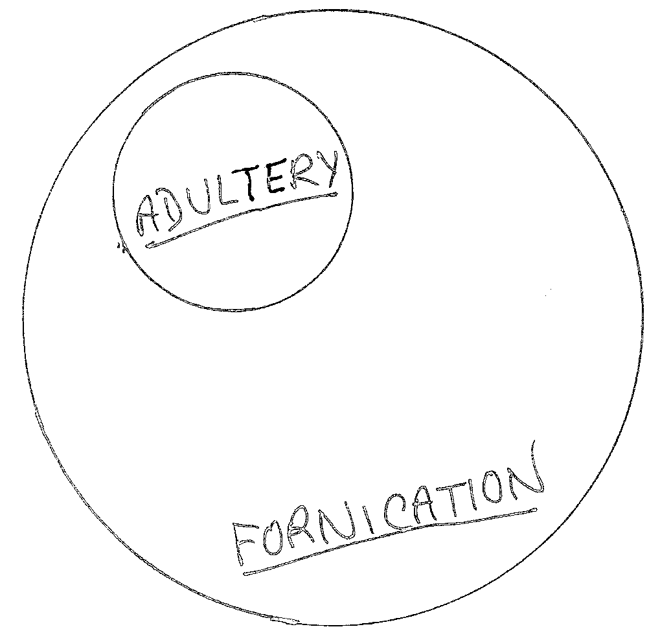
I. What Did This Mean to Them?

Slide 8
I. What Did This Mean to Them?
B. What was the punishment for adultery in the Old Testament?

Slide 9
I. What Did This Mean to Them?
B. What was the punishment for adultery in the Old Testament?
Deuteronomy 22:22 - If a man is found sleeping with another man’s wife, both the man who slept with her and the woman must die. You must purge the evil from Israel.

Slide 10
I. What Did This Mean to Them?
B. What was the punishment for adultery in the Old Testament?
2. Why was this punishment so severe?

Slide 11
I. What Did This Mean to Them?
2. Why was this punishment so severe?
a. This union makes you more complete.

Slide 12
I. What Did This Mean to Them?
2. Why was this punishment so severe?
b. This union gives you more security.

Slide 13
I. What Did This Mean to Them?
2. Why was this punishment so severe?
c. This union protects you.

Slide 14
I. What Did This Mean to Them?
2. Why was this punishment so severe?
d. This union provides a spiritual bond.

Slide 15
I. What Did This Mean to Them?
2. Why was this punishment so severe?
e. What often happens when this bond is broken?

Slide 16
I. What Did This Mean to Them?
2. Why was this punishment so severe?
e. What often happens when this bond is broken?
Divorce!

Slide 17
I. What Did This Mean to Them?
2. Why was this punishment so severe?
e. What often happens when this bond is broken?
Malachi 2:16 - “I hate divorce”, says the LORD God of Israel . . .

Slide 18
I. What Did This Mean to Them?
C. What new dimension did the Lord place on it?

Slide 19
I. What Did This Mean to Them?
C. What new dimension did the Lord place on it?
1. The divorce aspect.
Matthew 5:32 - But I tell you that anyone who divorces his wife, except for marital unfaithfulness, causes her to become an adulteress, and anyone who marries the divorced woman commits adultery.

Slide 20
I. What Did This Mean to Them?
C. What new dimension did the Lord place on it?
2. The mental & emotional aspect.
Matthew 5:27-28 - You have heard that it was said, ‘Do not commit adultery.’ But I tell you that anyone who looks at a woman lustfully has already committed adultery with her in his heart.

Slide 21
I. What Did This Mean to Them?
C. What new dimension did the Lord place on it?
3. The forgiveness aspect.
John 8:1-11

Slide 22
I. What Did This Mean to Them?
II. What Should This Mean to You?

Slide 23
II. What Should This Mean to You?
A. Don’t entertain even the thought of adultery.
Matthew 5:28 - But I tell you that anyone who looks at a woman lustfully has already committed adultery with her in his heart.

Slide 24
II. What Should This Mean to You?
B. Don’t put yourself in vulnerable situations.
I Thessalonians 5:22 - Avoid every kind of evil.
King James Version = “Abstain from all appearances of evil”.

Slide 25
II. What Should This Mean to You?
C. Don’t let your marriage deteriorate.

Slide 26
II. What Should This Mean to You?
C. Don’t let your marriage deteriorate.
1. Temptation = when things are not right at home.

Slide 27
II. What Should This Mean to You?
C. Don’t let your marriage deteriorate.
1. Temptation = when things are not right at home.
2. Plan romance.

Slide 28
II. What Should This Mean to You?
C. Don’t let your marriage deteriorate.
1. Temptation = when things are not right at home.
2. Plan romance.
3. Enjoy one another’s company.

Slide 29
II. What Should This Mean to You?
C. Don’t let your marriage deteriorate.
4. Recall often your original attraction.

Slide 30
II. What Should This Mean to You?
God hates adultery!
God wants you to remain faithful to your mate always!
Work out problems!
Stick together!

