Slide 1
what a soldier of christ needs to know

Slide 2
There are 3 things an army
needs to know:

Slide 3
There are 3 things an army
needs to know:
1. The enemy.

Slide 4
There are 3 things an army
needs to know:
1. The enemy.
2. The location.

Slide 5
There are 3 things an army
needs to know:
1. The enemy.
2. The location.
3. Their own doctrine.

Slide 6
God’s word - here - informs you
about your spiritual enemy
and how you can win!

Slide 7
Ephesians 6:10-12
Finally, be strong in the Lord and in his mighty power. Put on the full armor of God so that you can take your stand against the devil’s schemes. For our struggle is not against flesh and blood, but against the rulers, against the authorities, against the powers of this dark world and against the spiritual forces of evil in the heavenly realms.

Slide 8
Ephesians 6:13-16
Therefore put on the full armor of God, so that when the day of evil comes, you may be able to stand your ground, and after you have done everything, to stand. Stand firm then, with the belt of truth buckled around your waist, with the breastplate of righteousness in place, and with your feet fitted with the readiness that comes from the gospel of peace. In addition to all this, take up the shield of faith, with which you can extinguish all the flaming arrows of the evil one.

Slide 9
Ephesians 6:17-20
Take the helmet of salvation and the sword of the Spirit, which is the word of God. And pray in the Spirit on all occasions with all kinds of prayers and requests. With this in mind, be alert and always keep on praying for all the saints. Pray also for me, that whenever I open my mouth, words may be given me so that I will fearlessly make known the mystery of the gospel, for which I am an ambassador in chains. Pray that I may declare it fearlessly, as I should.

Slide 10
I. Who is the Enemy? - v11-12

Slide 11
I. Who is the Enemy?
A. Why is it important to know the enemy?

Slide 12
I. Who is the Enemy?
B. Your spiritual enemy is the devil & his demons.

Slide 13
I. Who is the Enemy?
1. Who is he & what is his name?
Matthew 13:39 - . . . the enemy who sows them is the devil.

Slide 14
I. Who is the Enemy?
1. Who is he & what is his name?
Matthew 13:39 - . . . the enemy who sows them is the devil.
Luke 10:18 - He replied, “I saw Satan fall like lightning from heaven.

Slide 15
I. Who is the Enemy?
2. Satan has a kingdom.
Matthew 12:26 - If Satan drives out Satan, he is divided against himself. How then can his kingdom stand?

Slide 16
I. Who is the Enemy?
3. Satan has a mission.
Put on the full armor of God so that you can take your stand against the devil’s schemes. - v11

Slide 17
I. Who is the Enemy?
3. Satan has a mission.
Put on the full armor of God so that you can take your stand against the devil’s schemes. - v11
a. His purpose is to enslave you into his kingdom.

Slide 18
I. Who is the Enemy?
3. Satan has a mission.
Put on the full armor of God so that you can take your stand against the devil’s schemes. - v11
b. Schemes * = wiles, strategies, deceitful methods.
II Corinthians 4:4 - The god of this age has blinded the minds of unbelievers, so that they cannot see the light of the gospel of the glory of Christ, who is the image of God. * μεθοδεία

Slide 19
I. Who is the Enemy?
4. What is his army?
Spiritual beings called demons.
For our struggle is not against flesh and blood, but against the rulers, against the authorities, against the powers of this dark world and against the spiritual forces of evil in the heavenly realms. - v12

Slide 20
I. Who is the Enemy?
4. What is his army?
Spiritual beings called demons.
For our struggle is not against flesh and blood, but against the rulers, against the authorities, against the powers of this dark world and against the spiritual forces of evil in the heavenly realms. - v12

Slide 21
I. Who is the Enemy?
4. What is his army?
Spiritual beings called demons.
For our struggle is not against flesh and blood, but against the rulers, against the authorities, against the powers of this dark world and against the spiritual forces of evil in the heavenly realms. - v12

Slide 22
I. Who is the Enemy?
4. What is his army?
Spiritual beings called demons.
For our struggle is not against flesh and blood, but against the rulers, against the authorities, against the powers of this dark world and against the spiritual forces of evil in the heavenly realms. - v12
The struggle - not against demons themselves - but against the temptations they provide!

Slide 23
I. Who is the Enemy?
5. What is his fate?
Revelation 20:10 - And the devil, who deceived them, was thrown into the lake of burning sulfur, where the beast and the false prophet had been thrown.

Slide 24
I. Who is the Enemy? - v11-12
II. What is the Location?

Slide 25
II. What is the Location?
A. The battlefield is your mind.
Romans 12:2 - Do not conform any longer to the pattern of this world, but be transformed by the renewing of your mind.

Slide 26
II. What is the Location?
B. How do we know that?
The Temptations of our Lord!
Luke 4:1-13

Slide 27
II. What is the Location?
B. How do we know that?
The Temptations of our Lord!
Luke 4:1-13
James 1:14 - . . . each one is tempted when, by his own evil desire, he is dragged away and enticed.

Slide 28
I. Who is the Enemy? - v11-12
II. What is the Location?
III. What Will Make You Victorious? - v10, 13-20

Slide 29
II. What Will Make You Victorious?
A. What must you do with what you have been given?
Therefore put on the full armor of God . . . - v13

Slide 30
II. What Will Make You Victorious?
A. What must you do with what you have been given?
Therefore put on the full armor of God . . . - v13
1. Put on * = lift up & carry, bring it along.
* ἀναλαμβάνω

Slide 31
II. What Will Make You Victorious?
A. What must you do with what you have been given?
Therefore put on the full armor of God . . . - v13
1. Put on * = lift up & carry, bring it along.
In addition to all this, take up the shield of faith - v16
* ἀναλαμβάνω

Slide 32
II. What Will Make You Victorious?
B. God gives you all you need for protection.
Stand firm then, with the belt of truth buckled around your waist, with the breastplate of righteousness in place, and with your feet fitted with the readiness that comes from the gospel of peace. In addition to all this, take up the shield of faith, with which you can extinguish all the flaming arrows of the evil one. Take the helmet of salvation and the sword of the Spirit, which is the word of God. - v14-17

Slide 33
II. What Will Make You Victorious?
B. God gives you all you need for protection.
Stand firm then, with the belt of truth buckled around your waist . . . - v14

Slide 34
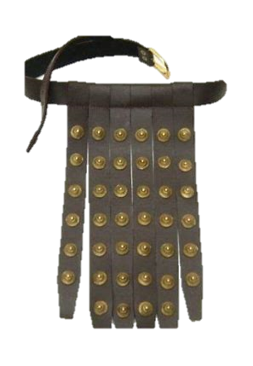
II. What Will Make You Victorious?
B. God gives you all you need for protection.
Stand firm then, with the belt of truth buckled around your waist . . . - v14
1. The Roman soldier’s belt.

Slide 35
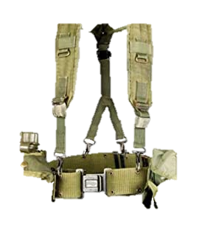
II. What Will Make You Victorious?
B. God gives you all you need for protection.
Stand firm then, with the belt of truth buckled around your waist . . . - v14
2. The modern soldier’s LBE.

Slide 36
II. What Will Make You Victorious?
B. God gives you all you need for protection.
Stand firm then, with the belt of truth buckled around your waist . . . - v14
1. The Roman soldier’s belt.
2. The modern soldier’s LBE.
3. Your belt is truth!

Slide 37
II. What Will Make You Victorious?
B. God gives you all you need for protection.
. . . with the breastplate of righteousness in place . . . - v14
Isaiah 59:17 - He put on righteousness as his breastplate, and the helmet of salvation on his head . . .

Slide 38
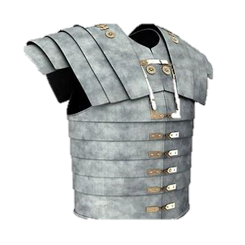
II. What Will Make You Victorious?
B. God gives you all you need for protection.
. . . with the breastplate of righteousness in place . . . - v14
1. The Roman soldier’s breastplate.

Slide 39
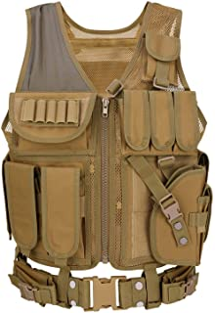
II. What Will Make You Victorious?
B. God gives you all you need for protection.
. . . with the breastplate of righteousness in place . . . - v14
2. The modern soldier’s flak jacket.

Slide 40
II. What Will Make You Victorious?
B. God gives you all you need for protection.
. . . with the breastplate of righteousness in place . . . - v14
3. Your breastplate is righteousness!

Slide 41
II. What Will Make You Victorious?
B. God gives you all you need for protection.
. . . and with your feet fitted with the readiness that comes from the gospel of peace. - v15

Slide 42
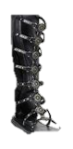
II. What Will Make You Victorious?
B. God gives you all you need for protection.
. . . and with your feet fitted with the readiness that comes from the gospel of peace. - v15
1. The Roman soldier’s sandals.

Slide 43
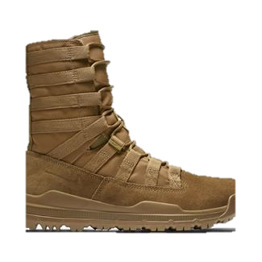
II. What Will Make You Victorious?
B. God gives you all you need for protection.
. . . and with your feet fitted with the readiness that comes from the gospel of peace. - v15
2. The modern soldier’s combat boots.

Slide 44
II. What Will Make You Victorious?
B. God gives you all you need for protection.
. . . and with your feet fitted with the readiness that comes from the gospel of peace. - v15
1. The Roman soldier’s sandals.
2. The modern soldier’s combat boots.
3. Your boots are the gospel!

Slide 45
II. What Will Make You Victorious?
B. God gives you all you need for protection.
In addition to all this, take up the shield of faith, with which you can extinguish all the flaming arrows of the evil one. - v16

Slide 46
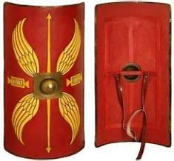
II. What Will Make You Victorious?
B. God gives you all you need for protection.
In addition to all this, take up the shield of faith, with which you can extinguish all the flaming arrows of the evil one. - v16
1. The Roman soldier’s shield.

Slide 47
II. What Will Make You Victorious?
B. God gives you all you need for protection.
In addition to all this, take up the shield of faith, with which you can extinguish all the flaming arrows of the evil one. - v16
1. The Roman soldier’s shield.
2. Your shield is faith!

Slide 48
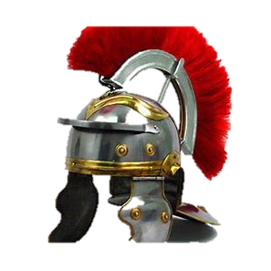
II. What Will Make You Victorious?
B. God gives you all you need for protection.
Take the helmet of salvation . . . - v16

Slide 49
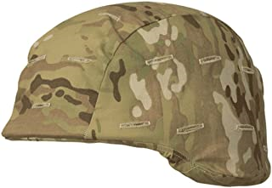
II. What Will Make You Victorious?
B. God gives you all you need for protection.
Take the helmet of salvation . . . - v17
1. The modern soldier’s kevlar helmet.

Slide 50
II. What Will Make You Victorious?
B. God gives you all you need for protection.
Take the helmet of salvation . . . - v17
1. The modern soldier’s kevlar helmet.
2. Your helmet is your hope of salvation!

Slide 51
II. What Will Make You Victorious?
C. God gives you all you need for offense.
. . . and the sword of the Spirit, which is the word of God. - v17

Slide 52
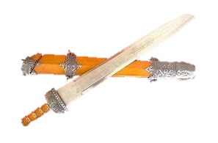
II. What Will Make You Victorious?
C. God gives you all you need for offense.
. . . and the sword of the Spirit, which is the word of God. - v17
1. The Roman soldier’s sword.

Slide 53
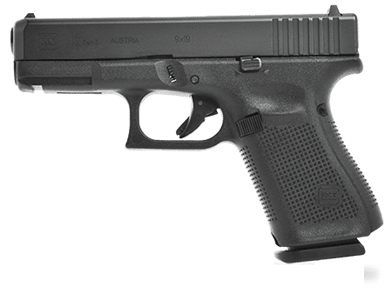

II. What Will Make You Victorious?
C. God gives you all you need for offense.
. . . and the sword of the Spirit, which is the word of God. - v17
2. The modern soldier’s weapons.

Slide 54
II. What Will Make You Victorious?
C. God gives you all you need for offense.
. . . and the sword of the Spirit, which is the word of God. - v17
1. The Roman soldier’s sword.
2. The modern soldier’s weapons.
3. Your primary spiritual weapon is the word of God!

Slide 55
II. What Will Make You Victorious?
C. God gives you all you need for offense.
. . . and the sword of the Spirit, which is the word of God. - v17
Hebrews 4:12 - For the word of God is living and active. Sharper than any double-edged sword, it penetrates even to dividing soul and spirit, joints and marrow; it judges the thoughts and attitudes of the heart.

Slide 56
II. What Will Make You Victorious?
C. God gives you all you need for offense.
. . . and the sword of the Spirit, which is the word of God. - v17
What does it do?
a. It is to comfort & encourage.

Slide 57
II. What Will Make You Victorious?
C. God gives you all you need for offense.
. . . and the sword of the Spirit, which is the word of God. - v17
What does it do?
a. It is to comfort & encourage.
b. It is to convict hearts.
Matthew 16:18

Slide 58
II. What Will Make You Victorious?
D. How do you get the strength you need for victory?
And pray in the Spirit on all occasions with all kinds of prayers and requests. With this in mind, be alert and always keep on praying for all the saints. Pray also for me, that whenever I open my mouth, words may be given me so that I will fearlessly make known the mystery of the gospel, for which I am an ambassador in chains. Pray that I may declare it fearlessly, as I should. - v18-20

Slide 59
II. What Will Make You Victorious?
D. How do you get the strength you need for victory?
1. The Roman communication system was their couriers.

Slide 60
II. What Will Make You Victorious?
D. How do you get the strength you need for victory?
1. The Roman communication system was their couriers.
2. The modern soldier’s commo.

Slide 61
II. What Will Make You Victorious?
3. You have prayer!
And pray in the Spirit on all occasions with all kinds of prayers and requests. With this in mind, be alert and always keep on praying for all the saints. - v18

Slide 62
II. What Will Make You Victorious?
3. You have prayer!
And pray in the Spirit on all occasions with all kinds of prayers and requests. With this in mind, be alert and always keep on praying for all the saints. - v18
a. It must be constant.
I Thessalonians 5:17 - pray continually.

Slide 63
II. What Will Make You Victorious?
3. You have prayer!
And pray in the Spirit on all occasions with all kinds of prayers and requests. With this in mind, be alert and always keep on praying for all the saints. - v18
b. It must be unselfish.

Slide 64
II. What Will Make You Victorious?
3. You have prayer!
And pray in the Spirit on all occasions with all kinds of prayers and requests. With this in mind, be alert and always keep on praying for all the saints. - v18
c. It must be intense.
Alert * = awake, without sleep.
* ἀγρυπνέω

Slide 65
II. What Will Make You Victorious?
3. You have prayer!
Pray also for me, that whenever I open my mouth, words may be given me so that I will fearlessly make known the mystery of the gospel. - v19
d. It must be for the right purpose.

Slide 66
Pray as though you really mean it!
That will give you power
in your life!

