Slide 1
how to receive a right relationship with God

Slide 2
“Hey man, trust me!”

Slide 3
“Hey man, trust me!”
With all these “great deals” who can you trust?

Slide 4
“Hey man, trust me!”
With all these “great deals” who can you trust?
You can trust Lord Jesus!

Slide 5
Romans 3:21-24
But now a righteousness from God, apart from law, has been made known, to which the Law and the Prophets testify. This righteousness from God comes through faith in Jesus Christ to all who believe. There is no difference, for all have sinned and fall short of the glory of God, and are justified freely by his grace through the redemption that came by Christ Jesus.

Slide 6
Romans 3:25-26
God presented him as a sacrifice of atonement, through faith in his blood. He did this to demonstrate his justice, because in his forbearance he had left the sins committed beforehand unpunished — he did it to demonstrate his justice at the present time, so as to be just and the one who justifies those who have faith in Jesus.

Slide 7
I. You Can Be a Sinner Without Even Trying.
. . . for all have sinned and fall short of the glory of God . . . - v23

Slide 8
I. You Can Be a Sinner Without Even Trying.
A. Everyone has sinned.
. . . for all have sinned and fall short of the glory of God . . . - v23

Slide 9
I. You Can Be a Sinner Without Even Trying.
A. Everyone has sinned.
1. Why doesn’t the teaching of Original Sin help people?

Slide 10
I. You Can Be a Sinner Without Even Trying.
A. Everyone has sinned.
1. Why doesn’t the teaching of Original Sin help people?
a. How can you feel guilty about what someone else did?

Slide 11
I. You Can Be a Sinner Without Even Trying.
A. Everyone has sinned.
1. Why doesn’t the teaching of Original Sin help people?
a. How can you feel guilty about what someone else did?
b. How can you repent about something someone else did?

Slide 12
I. You Can Be a Sinner Without Even Trying.
A. Everyone has sinned.
Ezekiel 18:20 - The soul who sins is the one who will die. The son will not share the guilt of the father, nor will the father share the guilt of the son. The righteousness of the righteous man will be credited to him, and the wickedness of the wicked will be charged against him.

Slide 13
I. You Can Be a Sinner Without Even Trying.
B. You are personally guilty of sin!

Slide 14
I. You Can Be a Sinner Without Even Trying.
B. You are personally guilty of sin!
1. Fall short * = did not attain a certain level.
* uστερέω (Present tense)

Slide 15
I. You Can Be a Sinner Without Even Trying.
B. You are personally guilty of sin!
2. How do you fall short?

Slide 16
I. You Can Be a Sinner Without Even Trying.
B. You are personally guilty of sin!
2. How do you fall short?
a. By not allowing God to truly rule within your heart.

Slide 17
I. You Can Be a Sinner Without Even Trying.
B. You are personally guilty of sin!
2. How do you fall short?
b. By conforming to the environ- ment around you instead of God’s purposes.
Romans 12:2 - Do not conform any longer to the pattern of this world, but be transformed by the renewing of your mind.

Slide 18
I. You Can Be a Sinner Without Even Trying.
B. You are personally guilty of sin!
3. It’s easy to be a sinner!

Slide 19
II. You Can Become a Saint Without Even Trying.
This righteousness from God comes through faith in Jesus Christ to all who believe . . . and are justified freely by his grace through the redemption that came by Christ Jesus. - v22 & 24

Slide 20
II. You Can Become a Saint Without Even Trying.
A. How do most people do it wrong?
But now a righteousness from God, apart from law, has been made known, to which the Law and the Prophets testify. - v21

Slide 21
II. You Can Become a Saint Without Even Trying.
A. How do most people do it wrong?
But now a righteousness from God, apart from law, has been made known, to which the Law and the Prophets testify. - v21
1. Righteousness * = bring right, having a right relationship.
* δικαιοσύνη

Slide 22
II. You Can Become a Saint Without Even Trying.
A. How do most people do it wrong?
But now a righteousness from God, apart from law, has been made known, to which the Law and the Prophets testify. - v21
2. This is apart from law - you can’t get to heaven by being good enough!

Slide 23
II. You Can Become a Saint Without Even Trying.
A. How do most people do it wrong?
Luke 16:26 - And besides all this, between us and you a great chasm has been fixed, so that those who want to go from here to you cannot, nor can anyone cross over from there to us.

Slide 24
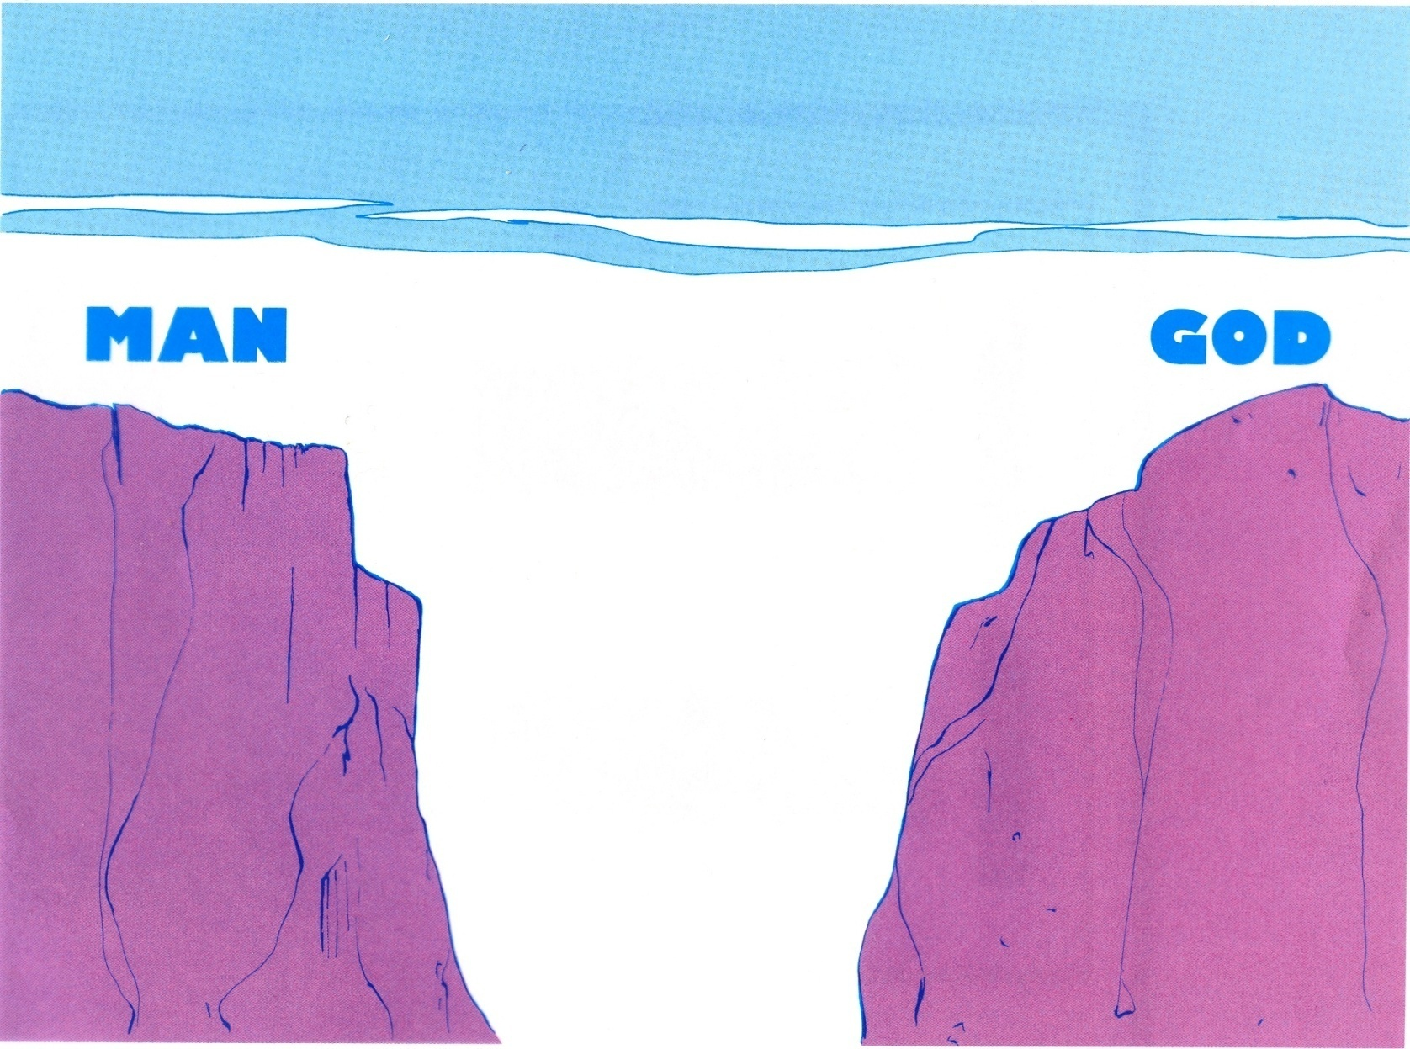
II. You Can Become a Saint Without Even Trying.

Slide 25
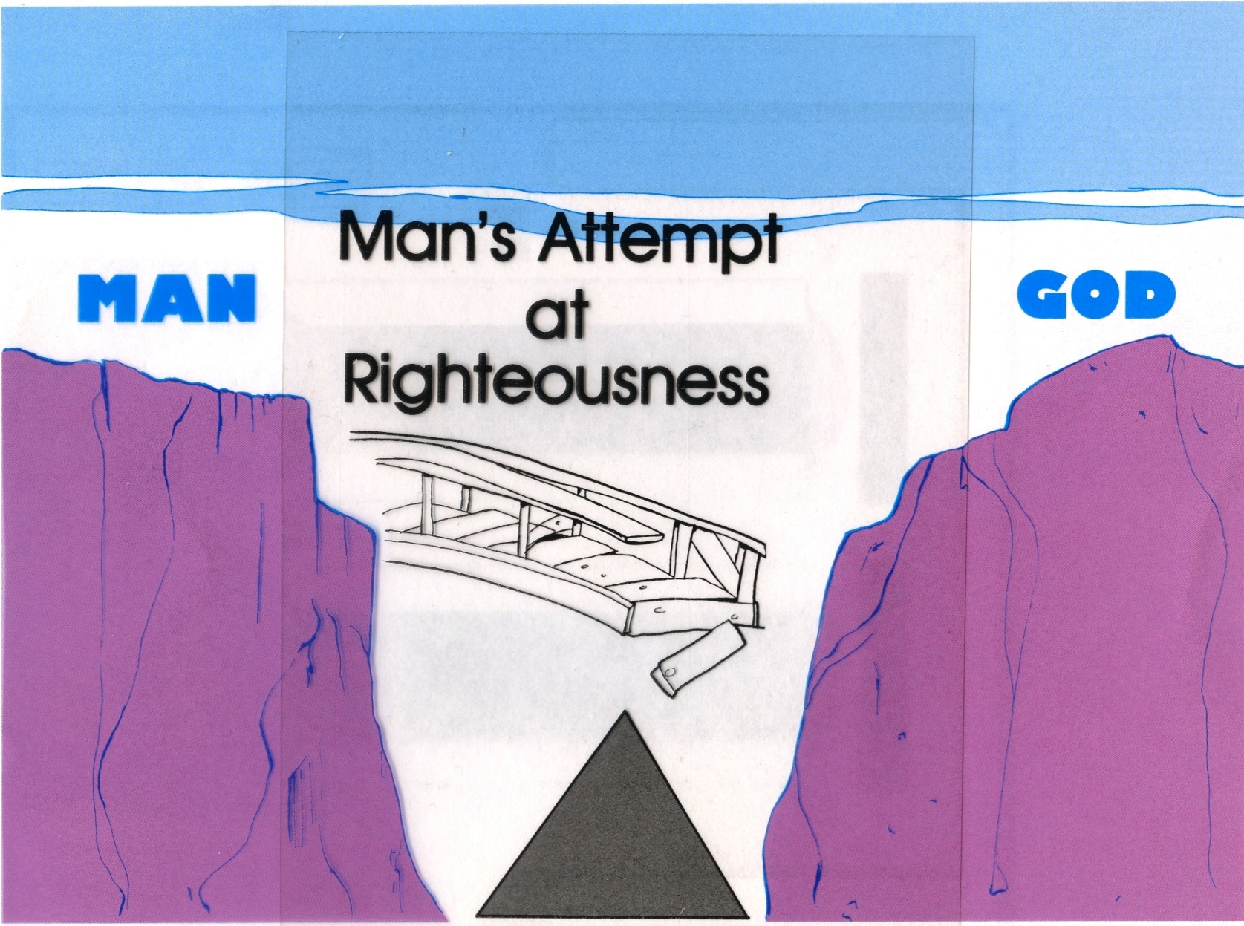
II. You Can Become a Saint Without Even Trying.

Slide 26
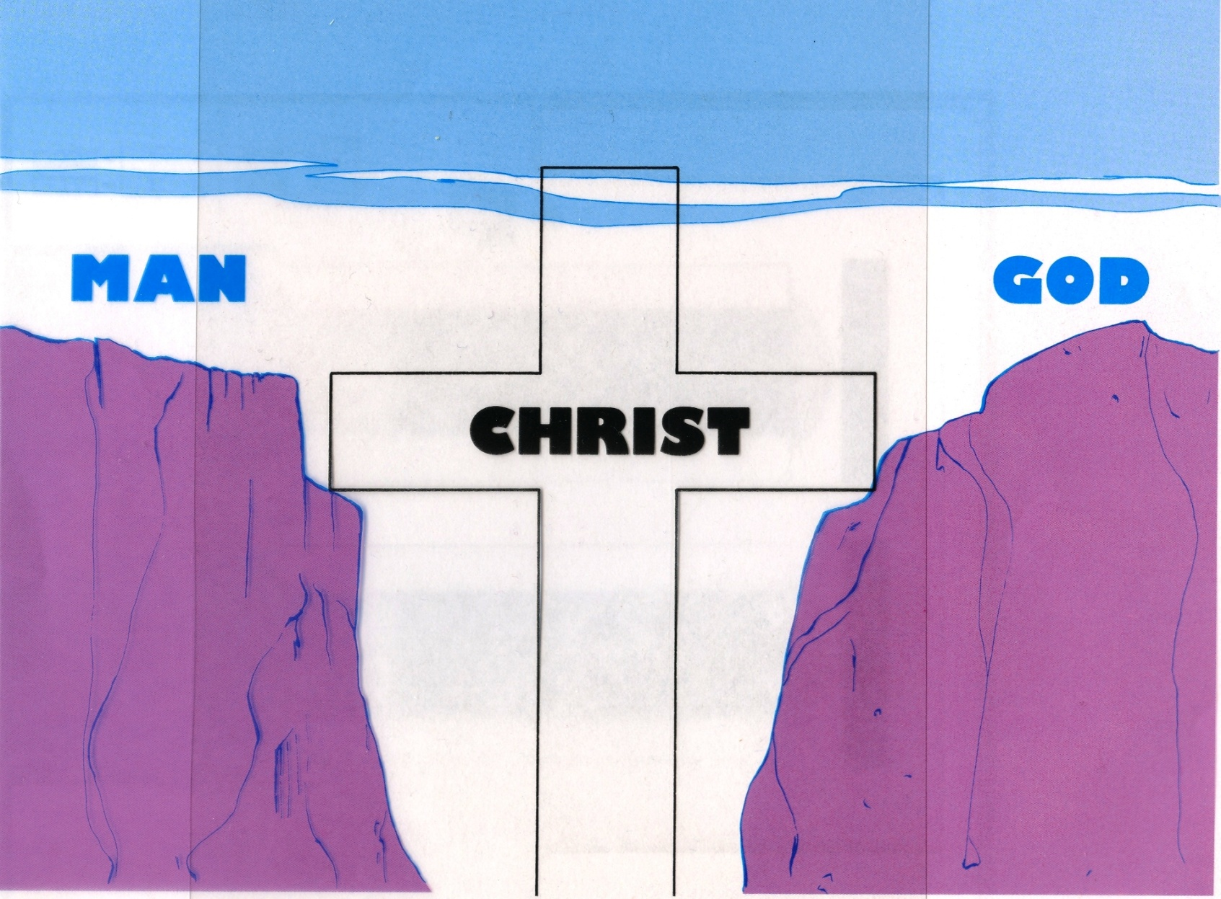
II. You Can Become a Saint Without Even Trying.

Slide 27
II. You Can Become a Saint Without Even Trying.
B. Where does this right relationship with God come from?
This righteousness from God comes through faith in Jesus Christ to all who believe. - v22

Slide 28
II. You Can Become a Saint Without Even Trying.
B. Where does this right relationship with God come from?
This righteousness from God comes through faith in Jesus Christ to all who believe. - v22
1. Faith & Belief * = trust!
* πίστις

Slide 29
II. You Can Become a Saint Without Even Trying.
B. Where does this right relationship with God come from?
1. “Faith” & “Belief” = trust!
2. The Lord is saying, “Hey man, trust Me!”

Slide 30
II. You Can Become a Saint Without Even Trying.
B. Where does this right relationship with God come from?
3. Examples of trust.
But now a righteousness from God, apart from law, has been made known, to which the Law and the Prophets testify. - v21

Slide 31
II. You Can Become a Saint Without Even Trying.
B. Where does this right relationship with God come from?
3. Examples of trust.
But now a righteousness from God, apart from law, has been made known, to which the Law and the Prophets testify. - v21
Abraham offering Isaac on the altar.
Genesis 22:1-18 & Hebrews 11:18

Slide 32
II. You Can Become a Saint Without Even Trying.
B. Where does this right relationship with God come from?
3. Examples of trust.
But now a righteousness from God, apart from law, has been made known, to which the Law and the Prophets testify. - v21
Job 1:22 - In all this, Job did not sin by charging God with wrongdoing.

Slide 33
II. You Can Become a Saint Without Even Trying.
C. Lord Jesus has proven He can be trusted!
. . . and are justified freely by his grace through the redemption that came by Christ Jesus. God presented him as a sacrifice of atonement, through faith in his blood. He did this to demonstrate his justice, because in his forbearance he had left the sins committed beforehand unpunished — he did it to demonstrate his justice at the present time, so as to be just and the one who justifies those who have faith in Jesus. - v24-26.

Slide 34
II. You Can Become a Saint Without Even Trying.
. . . and are justified freely by his grace through the redemption that came by Christ Jesus. God presented him as a sacrifice of atonement, through faith in his blood. He did this to demonstrate his justice, because in his forbearance he had left the sins committed beforehand unpunished — he did it to demonstrate his justice at the present time, so as to be just and the one who justifies those who have faith in Jesus. - v24-26.
1. He redeemed you.

Slide 35
II. You Can Become a Saint Without Even Trying.
. . . and are justified freely by his grace through the redemption that came by Christ Jesus. God presented him as a sacrifice of atonement, through faith in his blood. He did this to demonstrate his justice, because in his forbearance he had left the sins committed beforehand unpunished — he did it to demonstrate his justice at the present time, so as to be just and the one who justifies those who have faith in Jesus. - v24-26.
Redemption * = purchased, bought.
* aπολύτρωσις

Slide 36
II. You Can Become a Saint Without Even Trying.
. . . and are justified freely by his grace through the redemption that came by Christ Jesus. God presented him as a sacrifice of atonement, through faith in his blood. He did this to demonstrate his justice, because in his forbearance he had left the sins committed beforehand unpunished — he did it to demonstrate his justice at the present time, so as to be just and the one who justifies those who have faith in Jesus. - v24-26.
2. He became your sacrifice of atonement.

Slide 37
II. You Can Become a Saint Without Even Trying.
. . . and are justified freely by his grace through the redemption that came by Christ Jesus. God presented him as a sacrifice of atonement, through faith in his blood. He did this to demonstrate his justice, because in his forbearance he had left the sins committed beforehand unpunished — he did it to demonstrate his justice at the present time, so as to be just and the one who justifies those who have faith in Jesus. - v24-26.
Hebrews 9:22 - In fact, the law requires that nearly everything be cleansed with blood, and without the shedding of blood there is no forgiveness.

Slide 38
II. You Can Become a Saint Without Even Trying.
2. He became your sacrifice of atonement.
Sacrifice of Atonement * = propitiation, expiation.
* iλαστήριον

Slide 39
II. You Can Become a Saint Without Even Trying.
2. He became your sacrifice of atonement.
Sacrifice of Atonement * = propitiation, expiation.
Jesus became your “mercy seat”.
* iλαστήριον

Slide 40
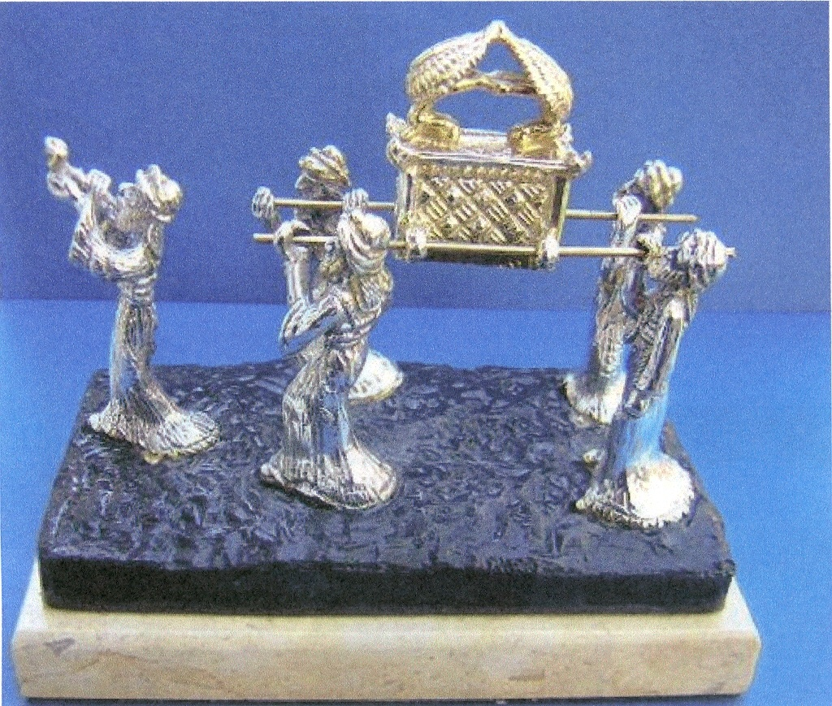

Slide 41
II. You Can Become a Saint Without Even Trying.
The Old Testament sacrifice died!

Slide 42
II. You Can Become a Saint Without Even Trying.
The Old Testament sacrifice died!
Jesus died!

Slide 43
II. You Can Become a Saint Without Even Trying.
The Old Testament sacrifice died!
Jesus died!
You die!
To your old life &
are resurrected to your new life
when you surrender to Jesus!

Slide 44
II. You Can Become a Saint Without Even Trying.
3. He satisfied the justice of God.
He did this to demonstrate his justice, because in his forbearance he had left the sins committed beforehand unpunished — he did it to demonstrate his justice at the present time, so as to be just and the one who justifies those who have faith in Jesus. - v25-26.

Slide 45
II. You Can Become a Saint Without Even Trying.
3. He satisfied the justice of God.
Romans 6:23 - For the wages of sin is death.

Slide 46
II. You Can Become a Saint Without Even Trying.
3. He satisfied the justice of God.
How?
a. Jesus died to pay the wages for your sin.

Slide 47
II. You Can Become a Saint Without Even Trying.
3. He satisfied the justice of God.
How?
a. Jesus died to pay the wages for your sin.
b. Since the wages have been paid, you don’t have to pay them!

Slide 48
II. You Can Become a Saint Without Even Trying.
3. He satisfied the justice of God.
How?
c. So when you trust Jesus - you don’t experience the consequences of your sins!

Slide 49
So - when Lord Jesus says to you, “Hey man - Trust Me!”
You can trust Him with your life!
Surrender to Him today as Lord of your life!

