Slide 1
what a good witness needs to know

Slide 2
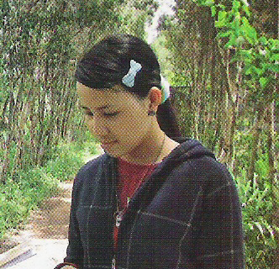

Slide 3
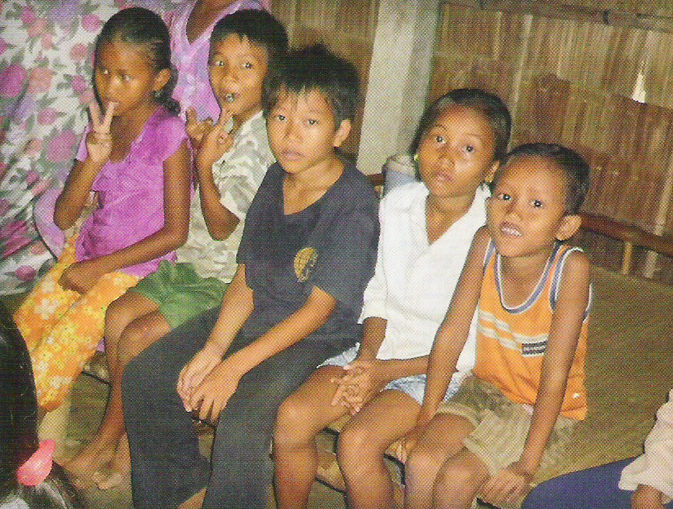

Slide 5
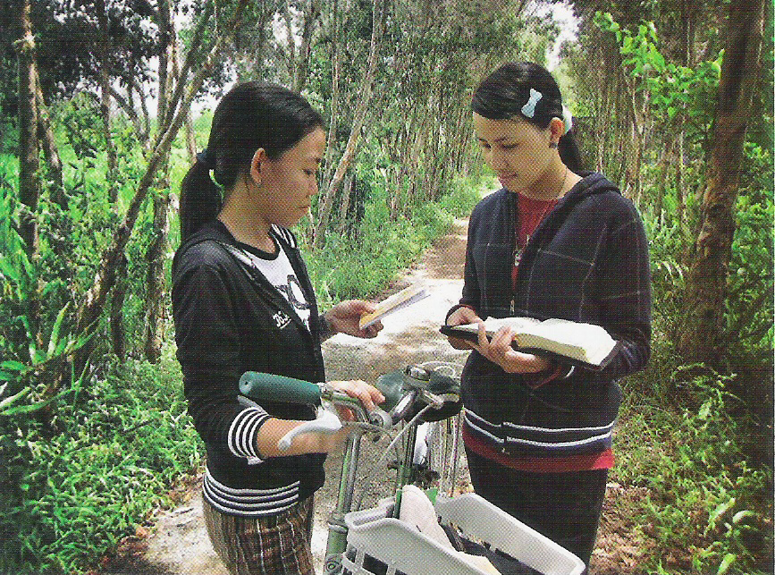

Slide 7
John 4:1-6
The Pharisees heard that Jesus was gaining and baptizing more disciples than John, although in fact it was not Jesus who baptized, but his disciples. When the Lord learned of this, he left Judea and went back once more to Galilee.
Now he had to go through Samaria. So he came to a town in Samaria called Sychar, near the plot of ground Jacob had given to his son Joseph. Jacob’s well was there, and Jesus, tired as he was from the journey, sat down by the well. It was about the sixth hour.

Slide 8
John 4:7-9
When a Samaritan woman came to draw water, Jesus said to her, “Will you give me a drink?” (His disciples had gone into the town to buy food.) The Samaritan woman said to him, “You are a Jew and I am a Samaritan woman. How can you ask me for a drink?” (For Jews do not associate with Samaritans.)

Slide 9
John 4:10-12
Jesus answered her, “If you knew the gift of God and who it is that asks you for a drink, you would have asked him and he would have given you living water.” “Sir,” the woman said, “you have nothing to draw with and the well is deep. Where can you get this living water? Are you greater than our father Jacob, who gave us the well and drank from it himself, as did also his sons and his flocks and herds?”

Slide 10
John 4:13-15
Jesus answered, “Everyone who drinks this water will be thirsty again, but whoever drinks the water I give him will never thirst. Indeed, the water I give him will become in him a spring of water welling up to eternal life.” The woman said to him, “Sir, give me this water so that I won’t get thirsty and have to keep coming here to draw water.”

Slide 11
John 4:16-20
He told her, “Go, call your husband and come back.” “I have no husband,” she replied. Jesus said to her, “You are right when you say you have no husband. The fact is, you have had five husbands, and the man you now have is not your husband. What you have just said is quite true.” “Sir,” the woman said, “I can see that you are a prophet. Our fathers worshiped on this mountain, but you Jews claim that the place where we must worship is in Jerusalem.”

Slide 12
John 4:21-24
Jesus declared, “Believe me, woman, a time is coming when you will worship the Father neither on this mountain nor in Jerusalem. You Samaritans worship what you do not know; we worship what we do know, for salvation is from the Jews. Yet a time is coming and has now come when the true worshipers will worship the Father in spirit and truth, for they are the kind of worshipers the Father seeks. God is spirit, and his worshipers must worship in spirit and in truth.”

Slide 13
John 4:25-26
The woman said, “I know that Messiah” (called Christ) “is coming. When he comes, he will explain everything to us.” Then Jesus declared, “I who speak to you am he.”

Slide 14
John 4:27-30
Just then his disciples returned and were surprised to find him talking with a woman. But no one asked, “What do you want?” or “Why are you talking with her?” Then, leaving her water jar, the woman went back to the town and said to the people, “Come, see a man who told me everything I ever did. Could this be the Christ?” They came out of the town and made their way toward him.

Slide 15
John 4:31-35
Meanwhile his disciples urged him, “Rabbi, eat something.” But he said to them, “I have food to eat that you know nothing about.” Then his disciples said to each other, “Could someone have brought him food?” “My food,” said Jesus, “is to do the will of him who sent me and to finish his work. Do you not say, ‘Four months more and then the harvest’? I tell you, open your eyes and look at the fields! They are ripe for harvest.

Slide 16
I. Don’t Be Afraid of People Who are Different!
When a Samaritan woman came to draw water, Jesus said to her, “Will you give me a drink?” (His disciples had gone into the town to buy food.) The Samaritan woman said to him, “You are a Jew and I am a Samaritan woman. How can you ask me for a drink?” (For Jews do not associate with Samaritans.)
- v7-9

Slide 17
I. Don’t Be Afraid of People Who are Different!
A. Someone you wouldn’t want to associate with.

Slide 18
I. Don’t Be Afraid of People Who are Different!
A. Someone you wouldn’t want to associate with.
1. She was a woman.

Slide 19
I. Don’t Be Afraid of People Who are Different!
A. Someone you wouldn’t want to associate with.
1. She was a woman.
2. She was a foreigner.

Slide 20
I. Don’t Be Afraid of People Who are Different!
A. Someone you wouldn’t want to associate with.
1. She was a woman.
2. She was a foreigner.
3. She was immoral.

Slide 21
I. Don’t Be Afraid of People Who are Different!
B. Advise for witnessing.

Slide 22
I. Don’t Be Afraid of People Who are Different!
B. Advise for witnessing.
When a Samaritan woman came to draw water, Jesus said to her, “Will you give me a drink?” (His disciples had gone into the town to buy food.) - v7
The Lord used tact
to establish rapport!

Slide 23
I. Don’t Be Afraid of People Who are Different! - v7-9
II. Lord Jesus Wants to Perform His Ministry In & Through You! - v10-15

Slide 24
II. Lord Jesus Wants to Perform His Ministry
In & Through You!
A. How is Lord Jesus present today?
Jesus answered her, “If you knew the gift of God and who it is that asks you for a drink, you would have asked him and he would have given you living water.” - v10

Slide 25
II. Lord Jesus Wants to Perform His Ministry
In & Through You!
A. How is Lord Jesus present today?
Jesus answered her, “If you knew the gift of God and who it is that asks you for a drink, you would have asked him and he would have given you living water.” - v10
Acts 2:38 - “Repent and be baptized, every one of you, in the name of Jesus Christ for the forgiveness of your sins. And you will receive the gift of the Holy Spirit.

Slide 26
II. Lord Jesus Wants to Perform His Ministry
In & Through You!
B. How can you avoid being thirsty spiritually?
“Everyone who drinks this water will be thirsty again, but whoever drinks the water I give him will never thirst. Indeed, the water I give him will become in him a spring of water welling up to eternal life.” - v13-14

Slide 27
I. Don’t Be Afraid of People Who are Different! - v7-9
II. Lord Jesus Wants to Perform His Ministry In & Through You! - v10-15
III. Be Aware of Your Own Sin & Inadequacies! - v16-18

Slide 28
III. Be Aware of Your Own Sin & Inadequacies!
A. Evidence she may have been a prostitute.
“I have no husband,” she replied. Jesus said to her, “You are right when you say you have no husband. The fact is, you have had five husbands, and the man you now have is not your husband. What you have just said is quite true.” - v17-18

Slide 29
III. Be Aware of Your Own Sin & Inadequacies!
A. Evidence she may have been a prostitute.
“I have no husband,” she replied. Jesus said to her, “You are right when you say you have no husband. The fact is, you have had five husbands, and the man you now have is not your husband. What you have just said is quite true.” - v17-18
1. Her lifestyle: she was living with a man not her husband.

Slide 30
III. Be Aware of Your Own Sin & Inadequacies!
A. Evidence she may have been a prostitute.
Then, leaving her water jar, the woman went back to the town and said to the people, “Come, see a man who told me everything I ever did. Could this be the Christ?” They came out of the town and made their way toward him. - v28-30
2. The way she approached men.

Slide 31
III. Be Aware of Your Own Sin & Inadequacies!
B. This woman became sin conscious.
Jesus said to her, “You are right when you say you have no husband. The fact is, you have had five husbands, and the man you now have is not your husband. What you have just said is quite true.” “Sir,” the woman said, “I can see that you are a prophet. - v17-19

Slide 32
III. Be Aware of Your Own Sin & Inadequacies!
B. This woman became sin conscious.
Jesus said to her, “You are right when you say you have no husband. The fact is, you have had five husbands, and the man you now have is not your husband. What you have just said is quite true.” “Sir,” the woman said, “I can see that you are a prophet. - v17-19

Slide 33
III. Be Aware of Your Own Sin & Inadequacies!
B. This woman became sin conscious.
Jesus said to her, “You are right when you say you have no husband. The fact is, you have had five husbands, and the man you now have is not your husband. What you have just said is quite true.” “Sir,” the woman said, “I can see that you are a prophet. - v17-19

Slide 34
III. Be Aware of Your Own Sin & Inadequacies!
B. This woman became sin conscious.
Advise for witnessing:
don’t get sidetracked!

Slide 35
III. Be Aware of Your Own Sin & Inadequacies!
B. This woman became sin conscious.
The right question:
not “What’s the right church?”
but “Who is the right Lord?”

Slide 36
IV. Your Ability to Witness is in Proportion to Your Devotional Life! - v19-26

Slide 37
IV. Your Ability to Witness is in Proportion
to Your Devotional Life!
A. How does the Lord dwell within you?
Through His Holy Spirit!

Slide 38
IV. Your Ability to Witness is in Proportion
to Your Devotional Life!
A. How does the Lord dwell within you?
1. He wants to perform His ministry through you.

Slide 39
IV. Your Ability to Witness is in Proportion
to Your Devotional Life!
A. How does the Lord dwell within you?
1. He wants to perform His ministry through you.
2. The restriction: your unwilling- ness to be used!

Slide 40
IV. Your Ability to Witness is in Proportion
to Your Devotional Life!
B. What is the real question?
1. Not “Where do you go to church?” but “What are you doing with Jesus?”
Jesus declared, “Believe me, woman, a time is coming when you will worship the Father neither on this mountain nor in Jerusalem . . . God is spirit, and his worshipers must worship in spirit and in truth.” - v21 & 24

Slide 41
IV. Your Ability to Witness is in Proportion
to Your Devotional Life!
B. What is the real question?
2. The question is coming to grips with “Who is the Lord Jesus?”
The woman said, “I know that Messiah” (called Christ) “is coming. When he comes, he will explain everything to us.” Then Jesus declared, “I who speak to you am he.” - v25-26

Slide 42
IV. Your Ability to Witness is in Proportion to Your Devotional Life! - v19-26
V. Enthusiasm & Zeal Can Often Overcome Personal Obstacles! - v28-35

Slide 43
V. Enthusiasm & Zeal Can Often
Overcome Personal Obstacles!
A. In spite of the obstacles, this woman had throngs of men coming out of Sychar to meet the one she was talking about!
Then, leaving her water jar, the woman went back to the town and said to the people, “Come, see a man who told me everything I ever did. Could this be the Christ?” They came out of the town and made their way toward him. - v28-30

Slide 44
V. Enthusiasm & Zeal Can Often
Overcome Personal Obstacles!
B. What did the Lord mean by ripe for harvest?
Do you not say, “Four months more and then the harvest”? I tell you, open your eyes and look at the fields! They are ripe for harvest. - v35
(KJV - white already to harvest.)

Slide 45
V. Enthusiasm & Zeal Can Often
Overcome Personal Obstacles!
C. Advise for witnessing.

Slide 46
V. Enthusiasm & Zeal Can Often
Overcome Personal Obstacles!
C. Advise for witnessing.
John 3:14-15 - Just as Moses lifted up the snake in the desert, so the Son of Man must be lifted up, that everyone who believes in him may have eternal life.

Slide 47
V. Enthusiasm & Zeal Can Often
Overcome Personal Obstacles!
C. Advise for witnessing.
John 3:14-15 - Just as Moses lifted up the snake in the desert, so the Son of Man must be lifted up, that everyone who believes in him may have eternal life.
1. The main objective: lift the Lord up!

Slide 48
V. Enthusiasm & Zeal Can Often
Overcome Personal Obstacles!
C. Advise for witnessing.
John 3:14-15 - Just as Moses lifted up the snake in the desert, so the Son of Man must be lifted up, that everyone who believes in him may have eternal life.
2. Tell the gospel story & sow seeds of salvation!
Romans 10:17 - Faith comes from hearing the message, and the message is heard through the word of Christ.

Slide 49
Why Don’t We Hurry?

