Slide 1
the impact of god’s word

Slide 2
Luke 8:4-8
While a large crowd was gathering and people were coming to Jesus from town after town, he told this parable: “A farmer went out to sow his seed. As he was scattering the seed, some fell along the path; it was trampled on, and the birds of the air ate it up. Some fell on rock, and when it came up, the plants withered because they had no moisture. Other seed fell among thorns, which grew up with it and choked the plants. Still other seed fell on good soil. It came up and yielded a crop, a hundred times more than was sown.” When he said this, he called out, “He who has ears to hear, let him hear”.

Slide 3
Luke 8:11-13
“This is the meaning of the parable: The seed is the word of God. Those along the path are the ones who hear, and then the devil comes and takes away the word from their hearts, so that they may not believe and be saved. Those on the rock are the ones who receive the word with joy when they hear it, but they have no root. They believe for a while, but in the time of testing they fall away.

Slide 4
Luke 8:14-15
The seed that fell among thorns stands for those who hear, but as they go on their way they are choked by life’s worries, riches and pleasures, and they do not mature. But the seed on good soil stands for those with a noble and good heart, who hear the word, retain it, and by persevering produce a crop.

Slide 5
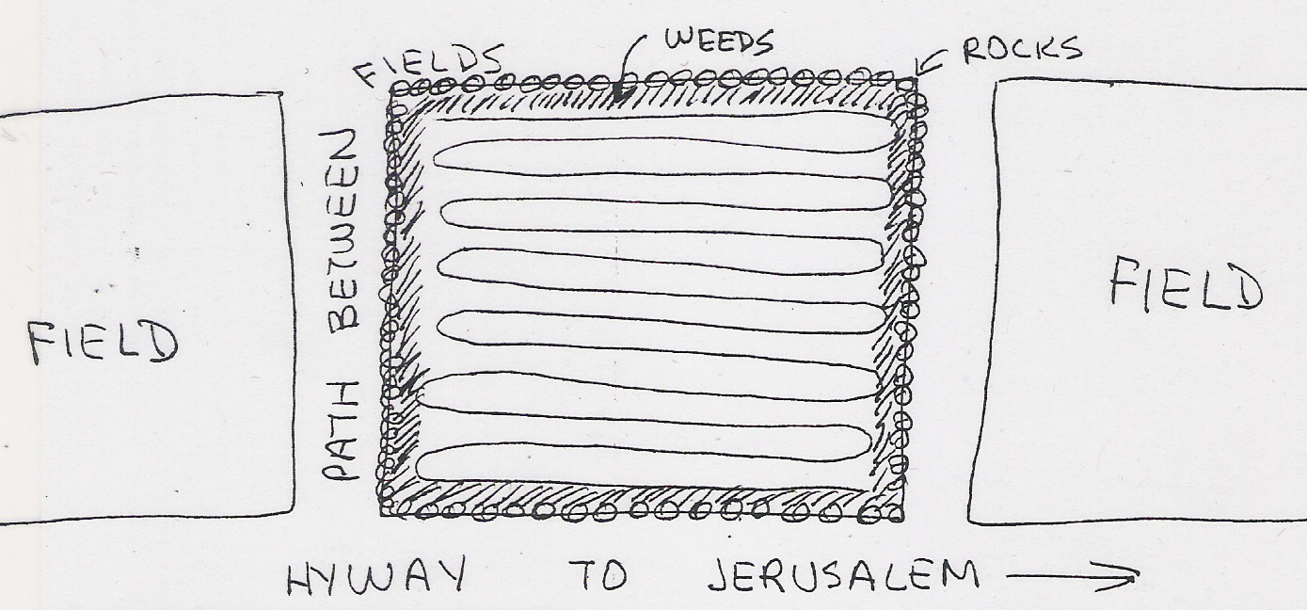

Slide 6
I. The Hard Heart

Slide 7
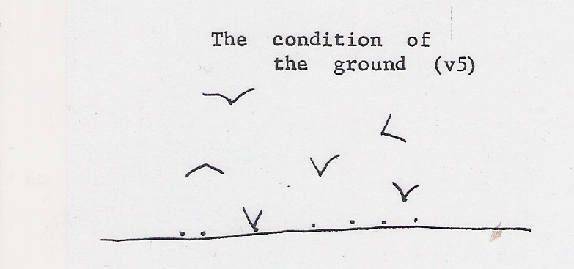
I. The Hard Heart
A. The condition of the ground.
Luke 8:5 - A farmer went out to sow his seed. As he was scattering the seed, some fell along the path; it was trampled on, and the birds of the air ate it up.

Slide 8
I. The Hard Heart
A. The condition of the ground.
1. What was the condition?

Slide 9
I. The Hard Heart
A. The condition of the ground.
1. What was the condition?
2. How did that affect the seed?

Slide 10

I. The Hard Heart
B. The condition of your heart.
Luke 8:12 - Those along the path are the ones who hear, and then the devil comes and takes away the word from their hearts, so that they may not believe and be saved.

Slide 11
I. The Hard Heart
B. The condition of your heart.
1. Do you hear the word with a closed mind?

Slide 12
I. The Hard Heart
B. The condition of your heart.
1. Do you hear the word with a closed mind?
2. Are you too proud to be taught?

Slide 13
I. The Hard Heart
B. The condition of your heart.
1. Do you hear the word with a closed mind?
2. Are you too proud to be taught?
3. Are you so loyal to what you were taught in the past to consider something new?

Slide 14
I. The Hard Heart
II. The Shallow Heart

Slide 15
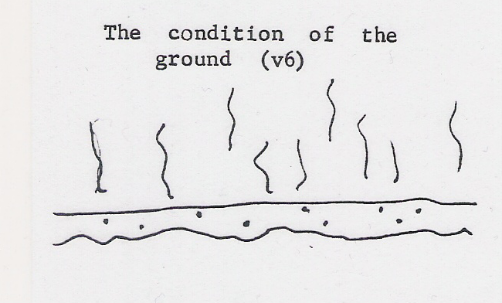
II. The Shallow Heart
A. The condition of the ground.
Luke 8:6 - Some fell on rock, and when it came up, the plants withered because they had no moisture.

Slide 16
II. The Shallow Heart
A. The condition of the ground.
1. What was the condition?

Slide 17
II. The Shallow Heart
A. The condition of the ground.
1. What was the condition?
2. How did that affect the seed?

Slide 18
II. The Shallow Heart
B. The condition of your heart.
Luke 8:13 - Those on the rock are the ones who receive the word with joy when they hear it, but they have no root. They believe for a while, but in the time of testing they fall away.

Slide 19
II. The Shallow Heart
B. The condition of your heart.
1. Are you quick to accept new ideas but don’t think them through?

Slide 20
II. The Shallow Heart
B. The condition of your heart.
1. Are you quick to accept new ideas but don’t think them through?
2. Do you drop an idea quickly for something else?

Slide 21
I. The Hard Heart
II. The Shallow Heart
III. The World Oriented Heart

Slide 22
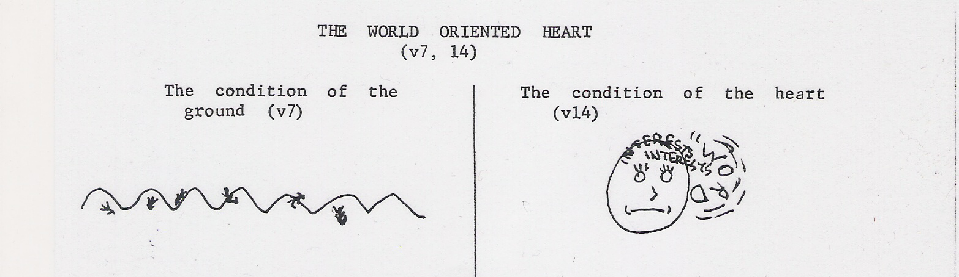
III. The World Oriented Heart
A. The condition of the ground.
Luke 8:7 - Other seed fell among thorns, which grew up with it and choked the plants.

Slide 23
III. The World Oriented Heart
A. The condition of the ground.
1. What was the condition?

Slide 24
III. The World Oriented Heart
A. The condition of the ground.
1. What was the condition?
2. How did that affect the seed?

Slide 25
III. The World Oriented Heart
B. The condition of your heart.
Luke 8:14 - The seed that fell among thorns stands for those who hear, but as they go on their way they are choked by life’s worries, riches and pleasures, and they do not mature.

Slide 26
III. The World Oriented Heart
B. The condition of your heart.
1. Do you allow the world’s interests to crowd out the word?

Slide 27
III. The World Oriented Heart
B. The condition of your heart.
1. Life’s worries * = care, anxiety.
* μέριμνα

Slide 28
III. The World Oriented Heart
Matthew 6:26-30
Look at the birds of the air; they do not sow or reap or store away in barns, and yet your heavenly Father feeds them. Are you not much more valuable than they? Who of you by worrying can add a single hour to his life? “And why do you worry about clothes? See how the lilies of the field grow. They do not labor or spin. Yet I tell you that not even Solomon in all his splendor was dressed like one of these. If that is how God clothes the grass of the field, which is here today and tomorrow is thrown into the fire, will he not much more clothe you, O you of little faith.

Slide 29
III. The World Oriented Heart
Matthew 6:26-30
Look at the birds of the air; they do not sow or reap or store away in barns, and yet your heavenly Father feeds them. Are you not much more valuable than they? Who of you by worrying can add a single hour to his life? “And why do you worry about clothes? See how the lilies of the field grow. They do not labor or spin. Yet I tell you that not even Solomon in all his splendor was dressed like one of these. If that is how God clothes the grass of the field, which is here today and tomorrow is thrown into the fire, will he not much more clothe you, O you of little faith.

Slide 30
III. The World Oriented Heart
B. The condition of your heart.
1. Life’s worries * = care, anxiety.
2. Riches ** = wealth, obtaining money.
* μέριμνα
** πλοῦτος

Slide 31
III. The World Oriented Heart
B. The condition of your heart.
1. Life’s worries * = care, anxiety.
2. Riches ** = wealth, obtaining money.
3. Pleasures *** = lust, sensual ideas.
* μέριμνα ** πλοῦτος *** ἡδονή

Slide 32
III. The World Oriented Heart
B. The condition of your heart.
4. These interests do not have to be bad ones, just be of more priority than the Lord!
Mary & Martha
Luke 10:38-42

Slide 33
I. The Hard Heart
II. The Shallow Heart
III. The World Oriented Heart
IV. The Receptive Heart

Slide 34
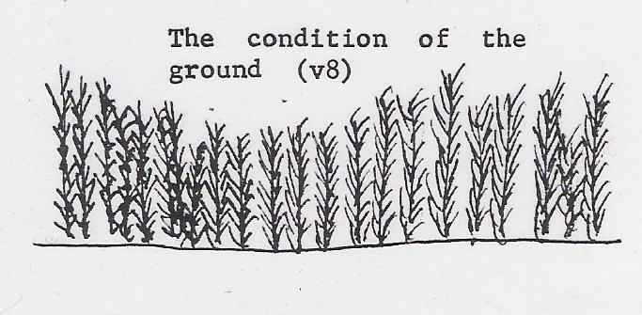
III. The Receptive Heart
A. The condition of the ground.
Luke 8:8 - Still other seed fell on good soil. It came up and yielded a crop, a hundred times more than was sown.

Slide 35
III. The Receptive Heart
A. The condition of the ground.
1. What was the condition?

Slide 36
III. The Receptive Heart
A. The condition of the ground.
1. What was the condition?
2. How did that affect the seed?

Slide 37
III. The Receptive Heart
B. The condition of your heart.
Luke 8:15 - But the seed on good soil stands for those with a noble and good heart, who hear the word, retain it, and by persevering produce a crop.

Slide 38
III. The Receptive Heart
B. The condition of your heart.
1. Do you listen with an open mind?

Slide 39
III. The Receptive Heart
B. The condition of your heart.
1. Do you listen with an open mind?
2. Are you willing to learn?

Slide 40
III. The Receptive Heart
B. The condition of your heart.
1. Do you listen with an open mind?
2. Are you willing to learn?
3. Are you prepared to hear?

Slide 41
III. The Receptive Heart
B. The condition of your heart.
1. Do you listen with an open mind?
2. Are you willing to learn?
3. Are you prepared to hear?
4. Do you understand & put into action what you hear?

Slide 42
III. The Receptive Heart
B. The condition of your heart.
James 2:14-17 - What good is it, my brothers, if a man claims to have faith but has no deeds? Can such faith save him? Suppose a brother or sister is without clothes and daily food. If one of you says to him, “Go, I wish you well; keep warm and well fed,” but does nothing about his physical needs, what good is it? In the same way, faith by itself, if it is not accompanied by action, is dead.

Slide 43
You have no idea how much good your witness can be!

Slide 44
Isaiah 55:10-11
As the rain and the snow come down from heaven, and do not return to it without watering the earth and making it bud and flourish, so that it yields seed for the sower and bread for the eater, so is my word that goes out from my mouth: It will not return to me empty, but will accomplish what I desire and achieve the purpose for which I sent it.

