Slide 1
How is love expressed in everyday living?

Slide 2
Luke 10:27
Love the Lord your God with all your heart and with all your soul and with all your strength and with all your mind; and, Love your neighbor as yourself.

Slide 3
Luke 10:27
Love the Lord your God with all your heart and with all your soul and with all your strength and with all your mind; and, Love your neighbor as yourself.
Deuteronomy 6:4-5

Slide 4
Luke 10:27
Love the Lord your God with all your heart and with all your soul and with all your strength and with all your mind; and, Love your neighbor as yourself.
Leviticus 19:18

Slide 5
How Can You Express Love in Everyday Living?

Slide 6
Luke 10:25-28
Then On one occasion an expert in the law stood up to test Jesus. “Teacher,” he asked, “what must I do to inherit eternal life?” “What is written in the Law?” he replied. “How do you read it?” He answered: “ ‘Love the Lord your God with all your heart and with all your soul and with all your strength and with all your mind’; and, ‘Love your neighbor as yourself.’” “You have answered correctly,” Jesus replied. “Do this and you will live.”

Slide 7
Luke 10:29-32
But he wanted to justify himself, so he asked Jesus, “And who is my neighbor?” In reply Jesus said: “A man was going down from Jerusalem to Jericho, when he fell into the hands of robbers. They stripped him of his clothes, beat him and went away, leaving him half dead. A priest happened to be going down the same road, and when he saw the man, he passed by on the other side. So too, a Levite, when he came to the place and saw him, passed by on the other side.

Slide 8
Luke 10:33-35
But a Samaritan, as he traveled, came where the man was; and when he saw him, he took pity on him. He went to him and bandaged his wounds, pouring on oil and wine. Then he put the man on his own donkey, took him to an inn and took care of him. The next day he took out two silver coins and gave them to the innkeeper. ‘Look after him,’ he said, ‘and when I return, I will reimburse you for any extra expense you may have.’

Slide 9
Luke 10:36-37
“Which of these three do you think was a neighbor to the man who fell into the hands of robbers?” The expert in the law replied, “The one who had mercy on him.” Jesus told him, “Go and do likewise.”

Slide 10
I. Love Demands Involvement
– v29-32 & 37

Slide 11
I. Love Demands Involvement.
A. Love * = a willingness to give of yourself to satisfy someone else’s need.
* ἀγαπάω

Slide 12
I. Love Demands Involvement.
A. Love * = a willingness to give of yourself to satisfy someone else’s need.
But someone will say, “You have faith; I have deeds.” Show me your faith without deeds, and I will show you my faith by what I do. - James 2:18
* ἀγαπάω

Slide 13
I. Love Demands Involvement.
B. How Can Love Be Commanded?

Slide 14
I. Love Demands Involvement.
B. How Can Love Be Commanded?
Love is an act of your will!

Slide 15
I. Love Demands Involvement.
B. How Can Love Be Commanded?
1. The location.

Slide 16
I. Love Demands Involvement.
B. How Can Love Be Commanded?
1. The location.
a. Mountainous.

Slide 17
I. Love Demands Involvement.
B. How Can Love Be Commanded?
1. The location.
a. Mountainous.
b. 2500’ above sea level to 700’ below sea level.

Slide 18
I. Love Demands Involvement.
B. How Can Love Be Commanded?
1. The location.
a. Mountainous.
b. 2500’ above sea level to 700’ below sea level.
c. Civilization: Bethany & the Inn.

Slide 19

I. Love Demands Involvement.

Slide 20

I. Love Demands Involvement.

Slide 21
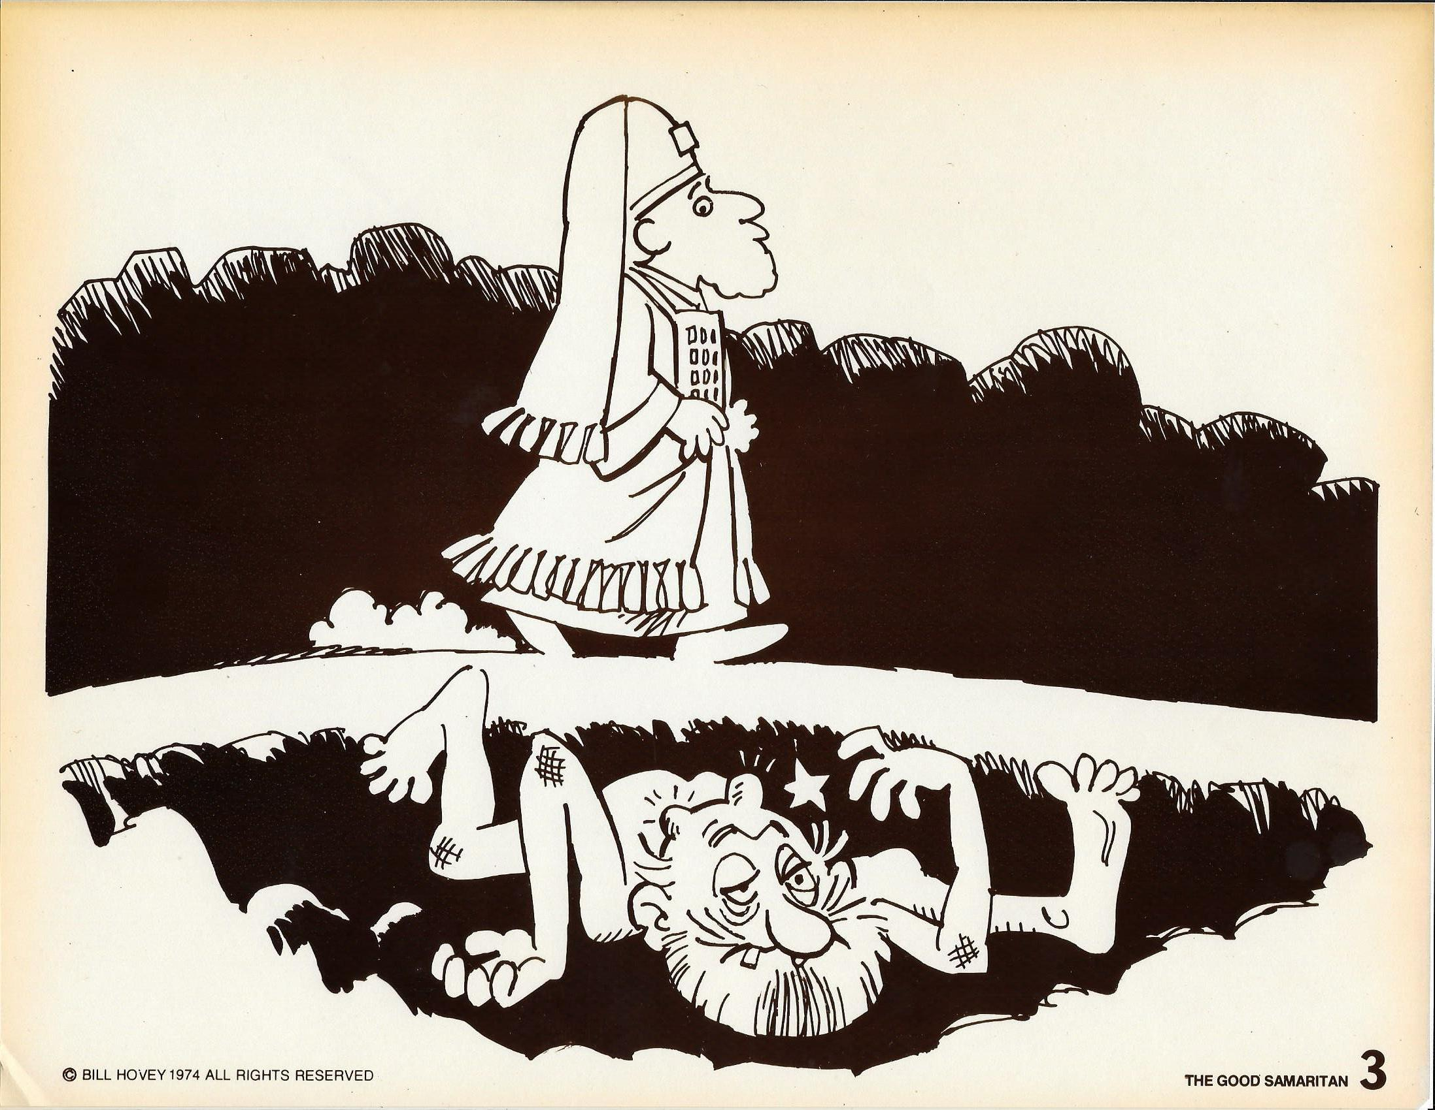
I. Love Demands Involvement.

Slide 22
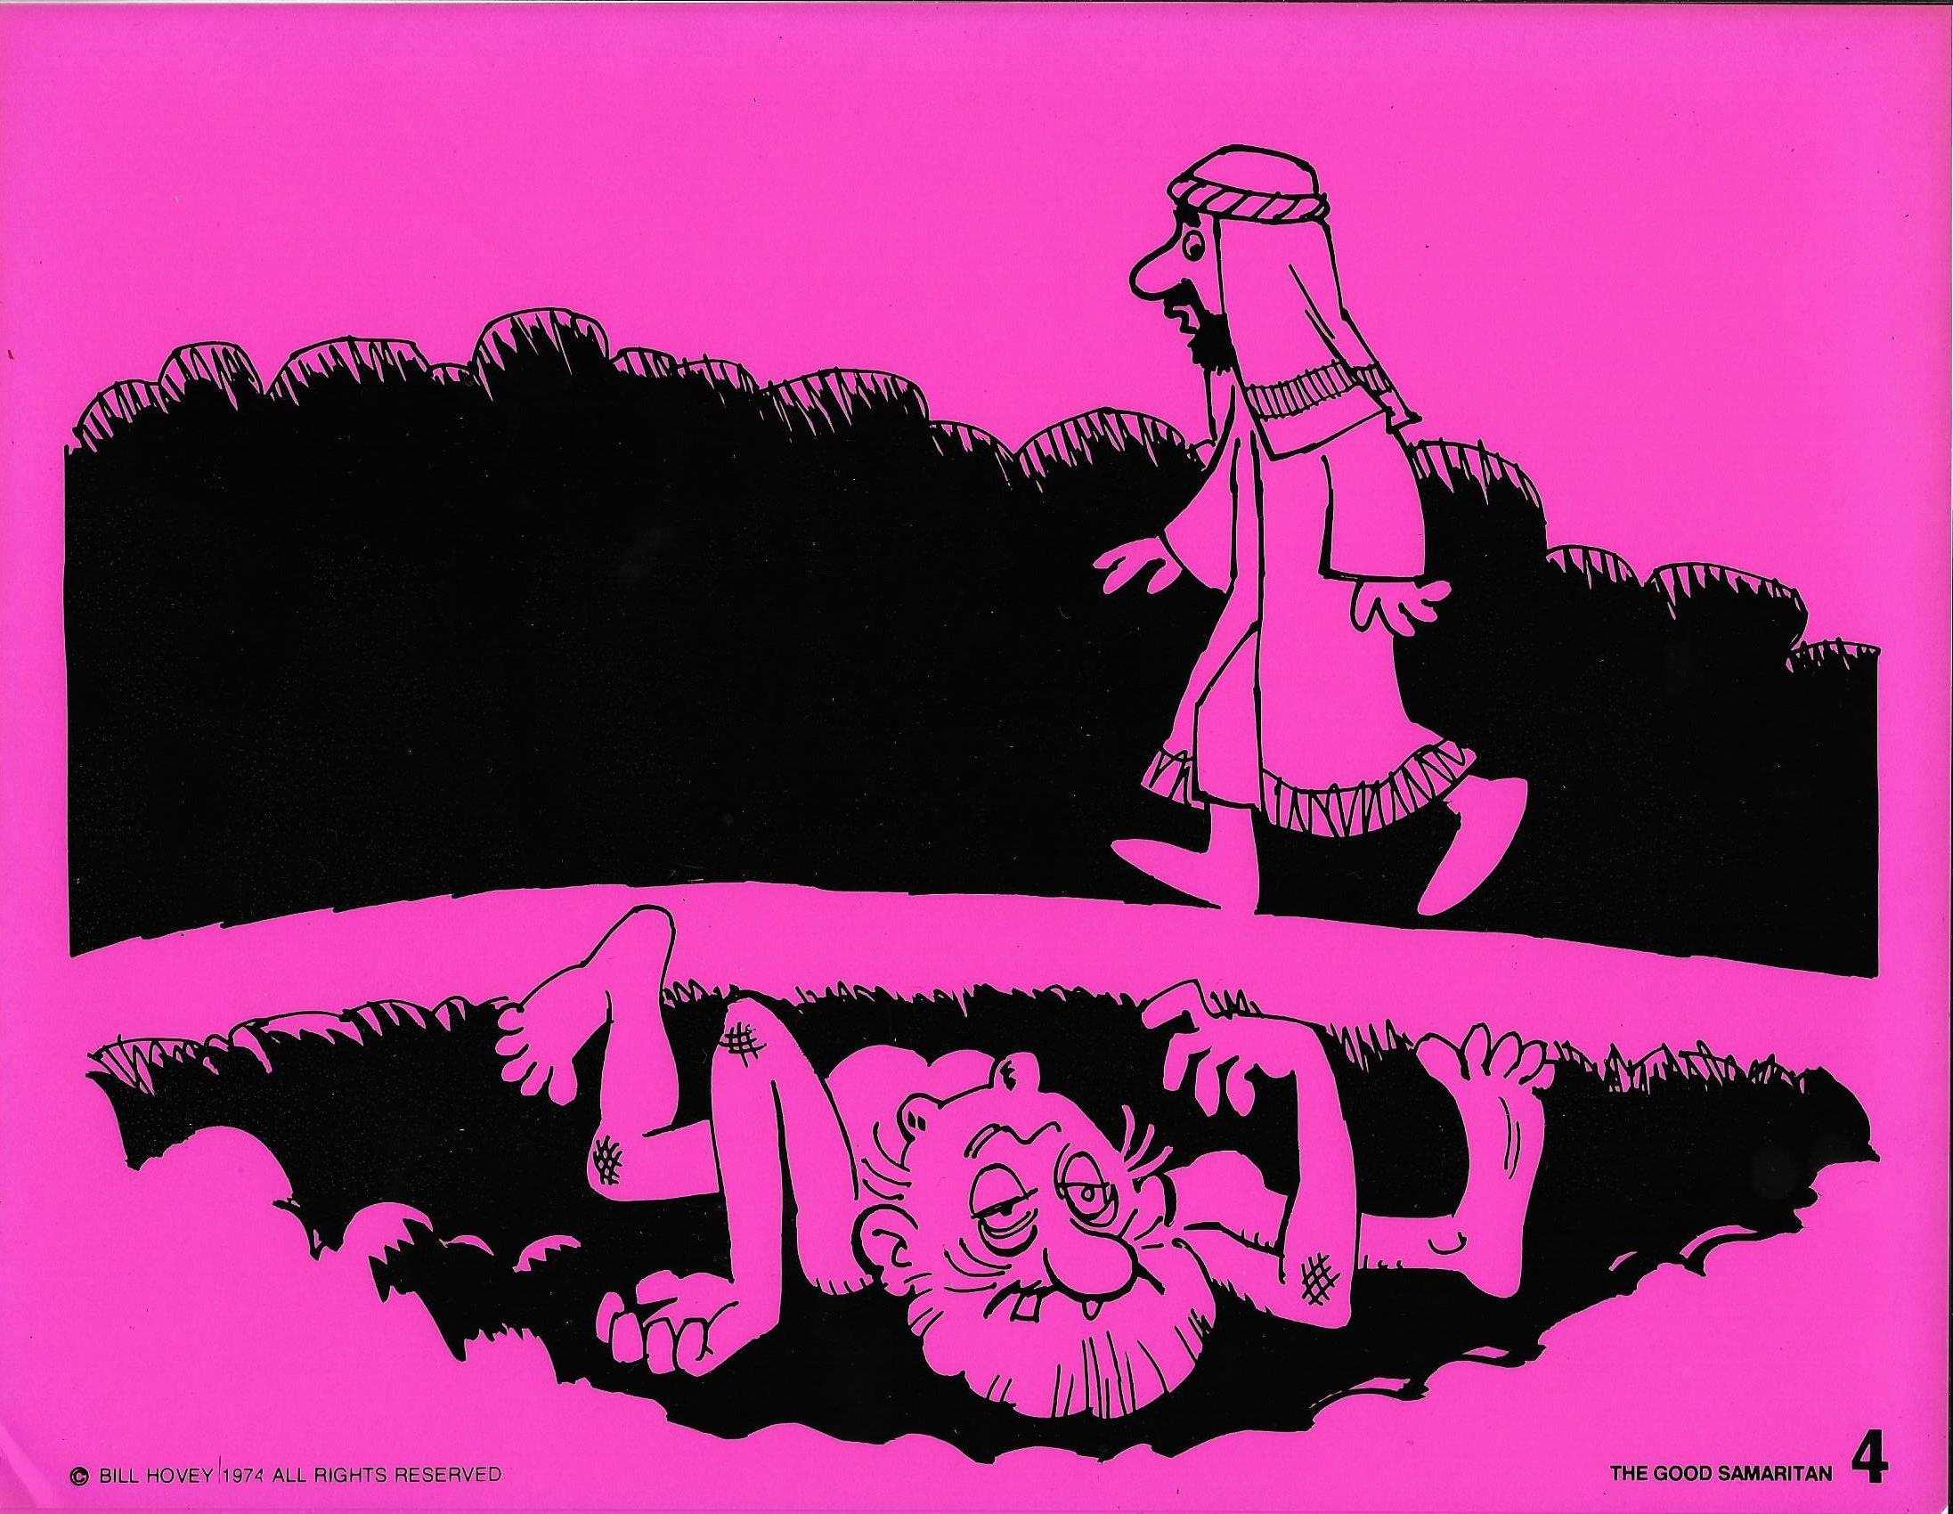
I. Love Demands Involvement.

Slide 23
I. Love Demands Involvement.
C. Neither Chose to Get Involved.

Slide 24
I. Love Demands Involvement.
C. Neither Chose to Get Involved.
1. Excuses for not helping.
a. It’s too dangerous.

Slide 25
I. Love Demands Involvement.
C. Neither Chose to Get Involved.
1. Excuses for not helping.
a. It’s too dangerous.
b. It might cost me money.

Slide 26
I. Love Demands Involvement.
C. Neither Chose to Get Involved.
1. Excuses for not helping.
a. It’s too dangerous.
b. It might cost me money.
c. Might take too much time.

Slide 27
I. Love Demands Involvement.
C. Neither Chose to Get Involved.
1. Excuses for not helping.
a. It’s too dangerous.
b. It might cost me money.
c. Might take too much time.
d. I would become unclean.

Slide 28
I. Love Demands Involvement
– v29-32 & 37
II. Love is Not Selective – v33 & 36-37

Slide 29
II. Love is Not Selective.
A. The Question: “Which of these three do you think was a neighbor to the man who fell into the hands of the robbers”?

Slide 30
II. Love is Not Selective.
A. The Question: “Which of these three do you think was a neighbor to the man who fell into the hands of the robbers”?
1. Neighbor * = one who is near.
* πλησίον

Slide 31
II. Love is Not Selective.
A. The Question: “Which of these three do you think was a neighbor to the man who fell into the hands of the robbers?
Proverbs 3:29 - Do not plot harm against your neighbor, who lives trustfully near you.

Slide 32
II. Love is Not Selective.
A. The Question: “Which of these three do you think was a neighbor to the man who fell into the hands of the robbers?
Proverbs 27:10 - Do not forsake your friend and the friend of your father, and do not go to your brother’s house when disaster strikes you — better a neighbor nearby than a brother far away.

Slide 33
II. Love is Not Selective.
A. The Question: “Which of these three do you think was a neighbor to the man who fell into the hands of the robbers?
Luke 15:6 - Then he calls his friends and neighbors together and says, ‘Rejoice with me; I have found my lost sheep.’

Slide 34
II. Love is Not Selective.
A. The Question: “Which of these three do you think was a neighbor to the man who fell into the hands of the robbers?
Luke 15:9 - She calls her friends and neighbors together and says, ‘Rejoice with me; I have found my lost coin.’

Slide 35
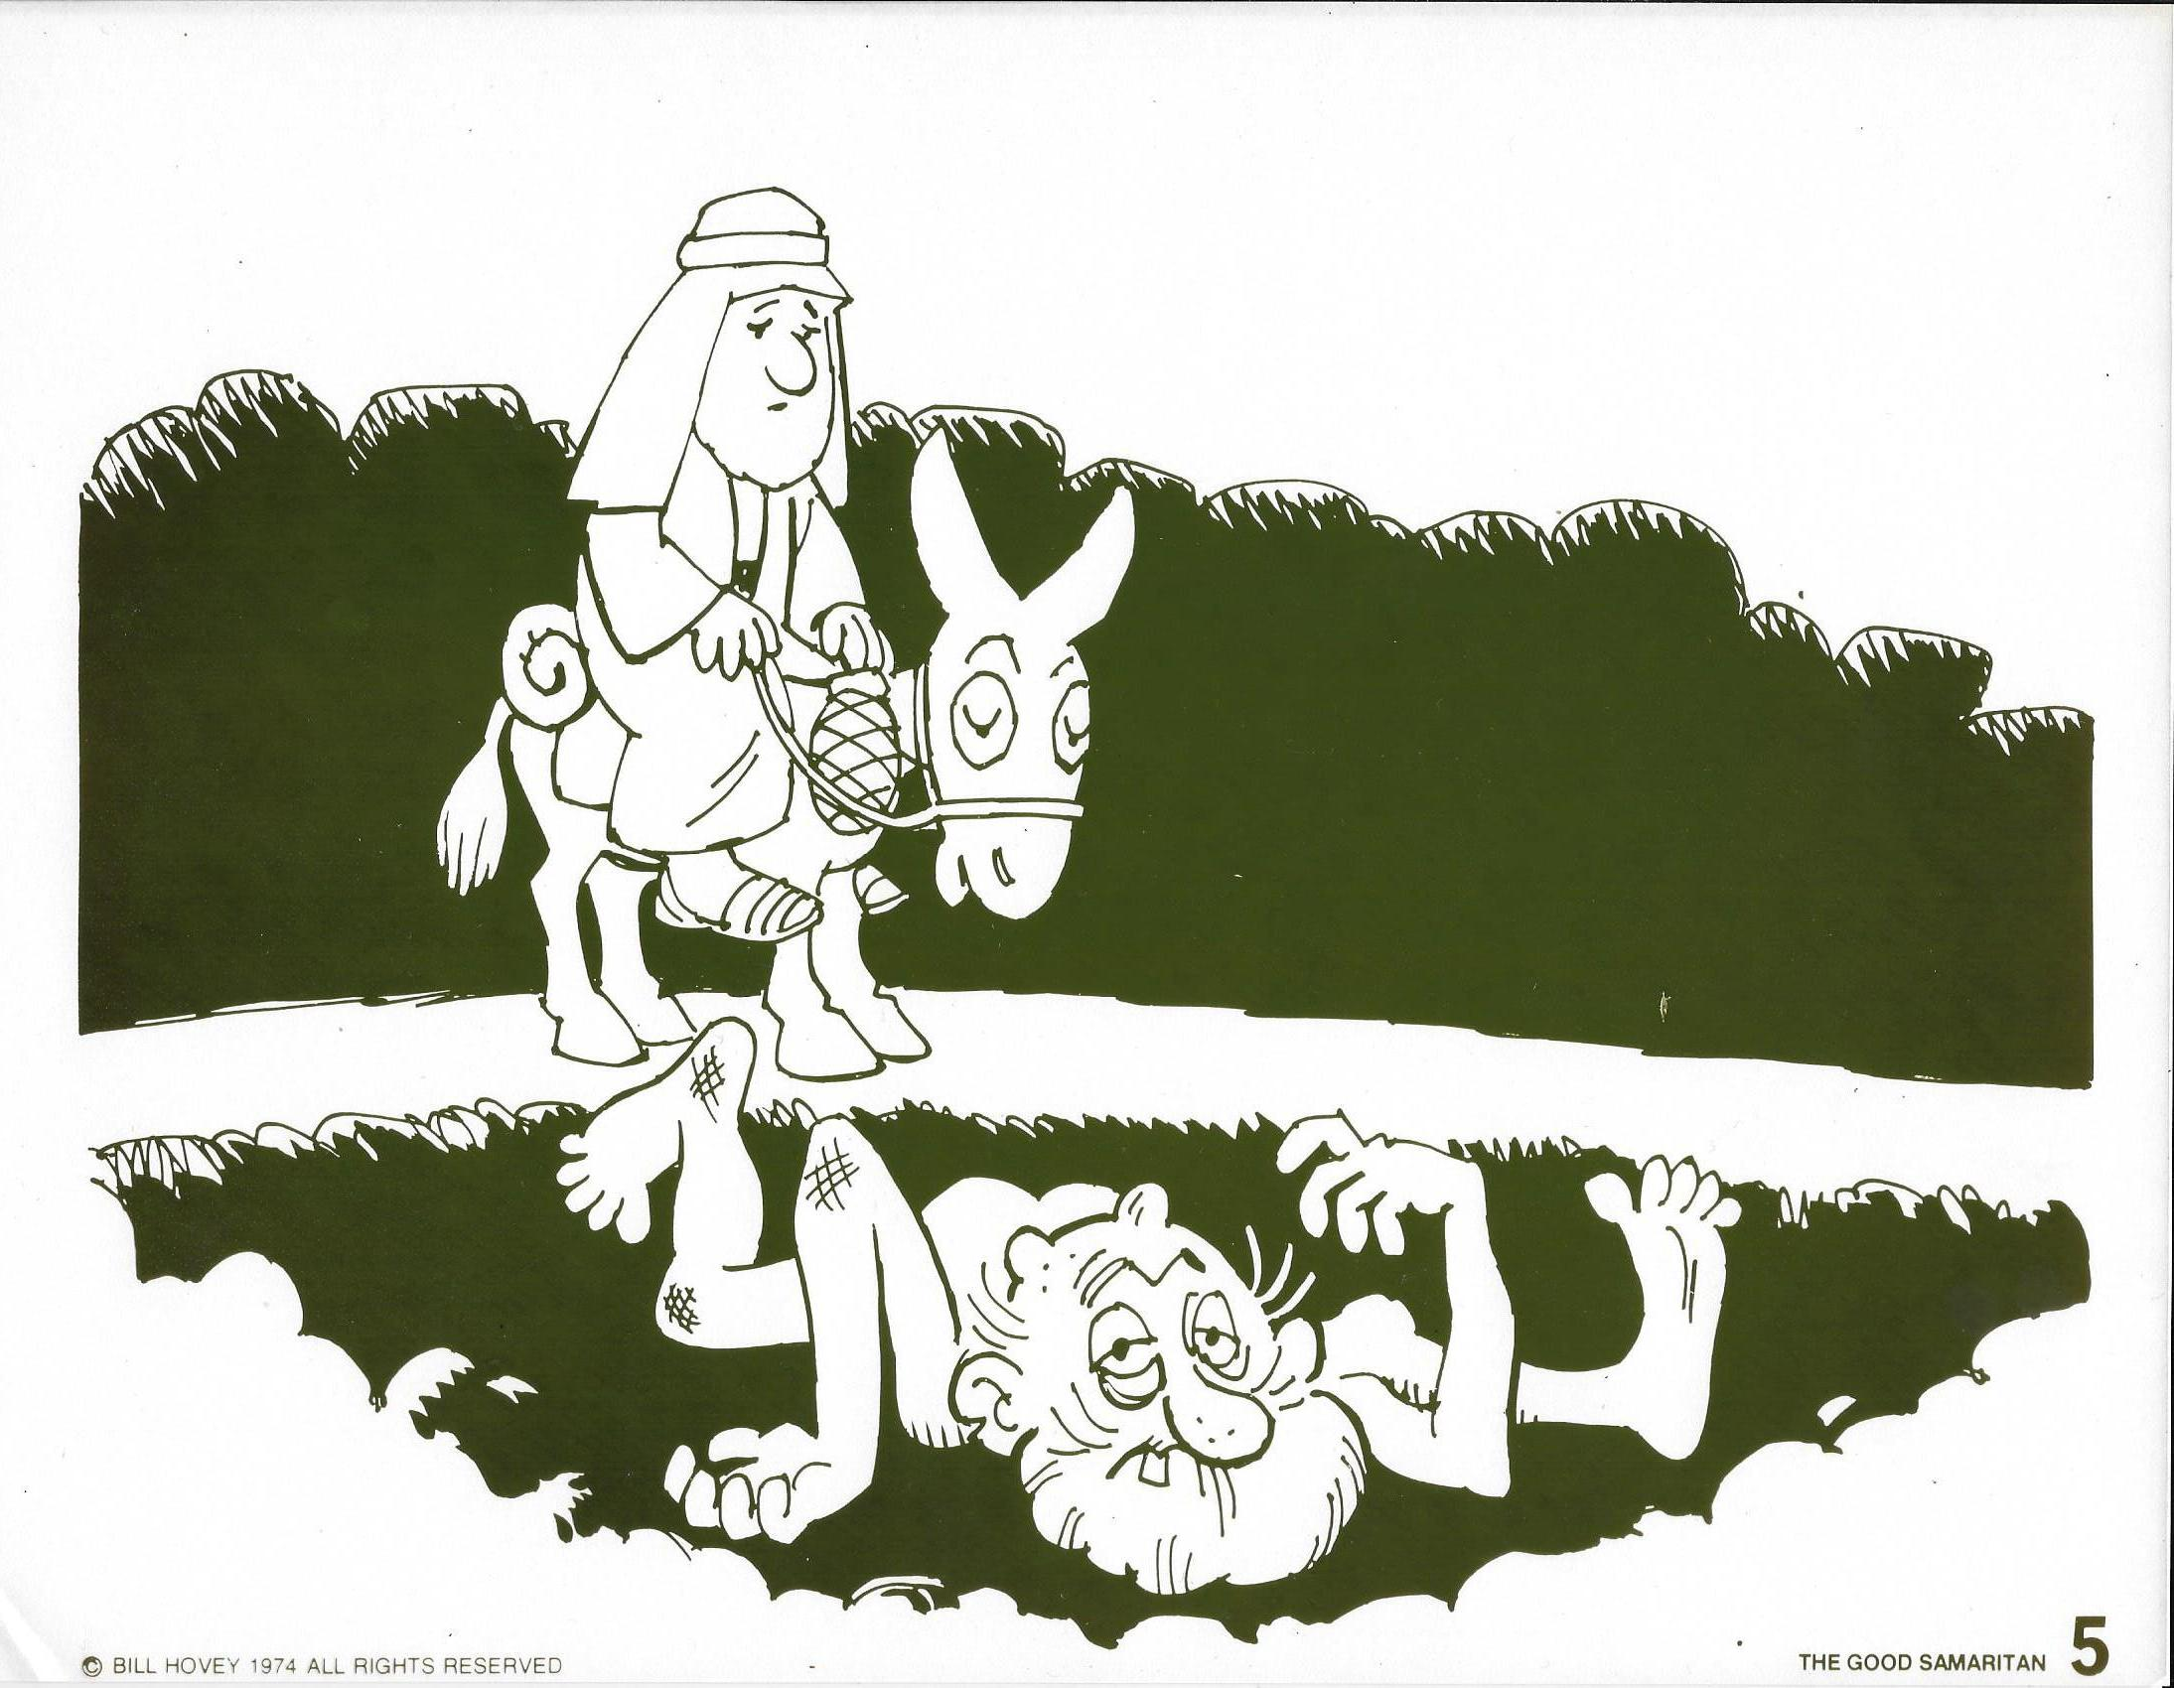
III. Love is Not Selective.

Slide 36
II. Love is Not Selective.
B. The Lord’s Application of Love
(Sermon on the Mount)

Slide 37
II. Love is Not Selective.
B. The Lord’s Application of Love
(Sermon on the Mount)
1. Enemies.
2. Romans.
3. The wealthy.

Slide 38
II. Love is Not Selective.
C. Worthiness is Not a Condition for Love!
Luke 15:11-32

Slide 39
I. Love Demands Involvement
– v29-32 & 37
II. Love is Not Selective – v33 & 36-37
III. Love Does Not Count the Cost – v34-35

Slide 40
III. Love Does Not Count the Cost.
A. Rules Set Limits – Love Satisfies Needs!

Slide 41
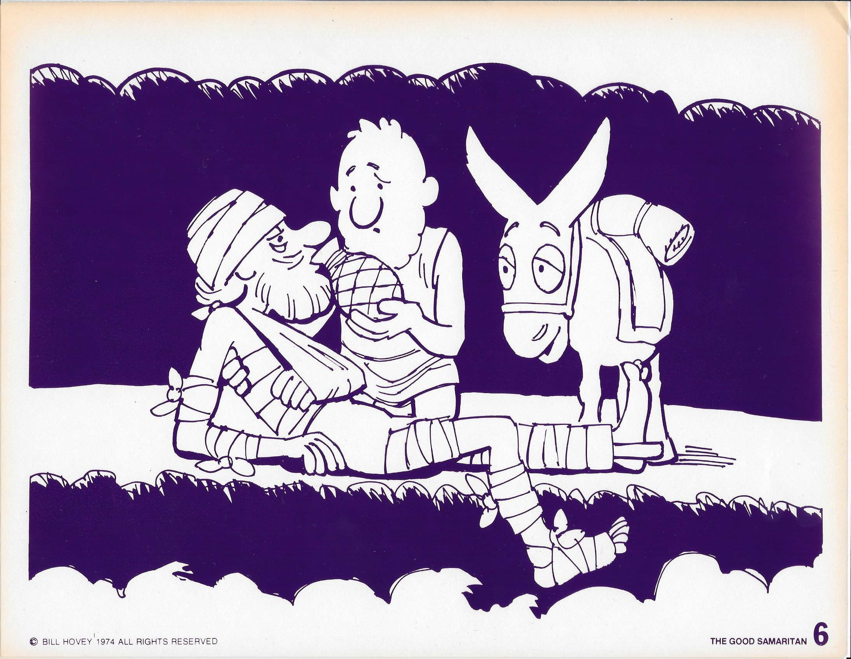
III. Love Does Not Count the Cost.

Slide 42
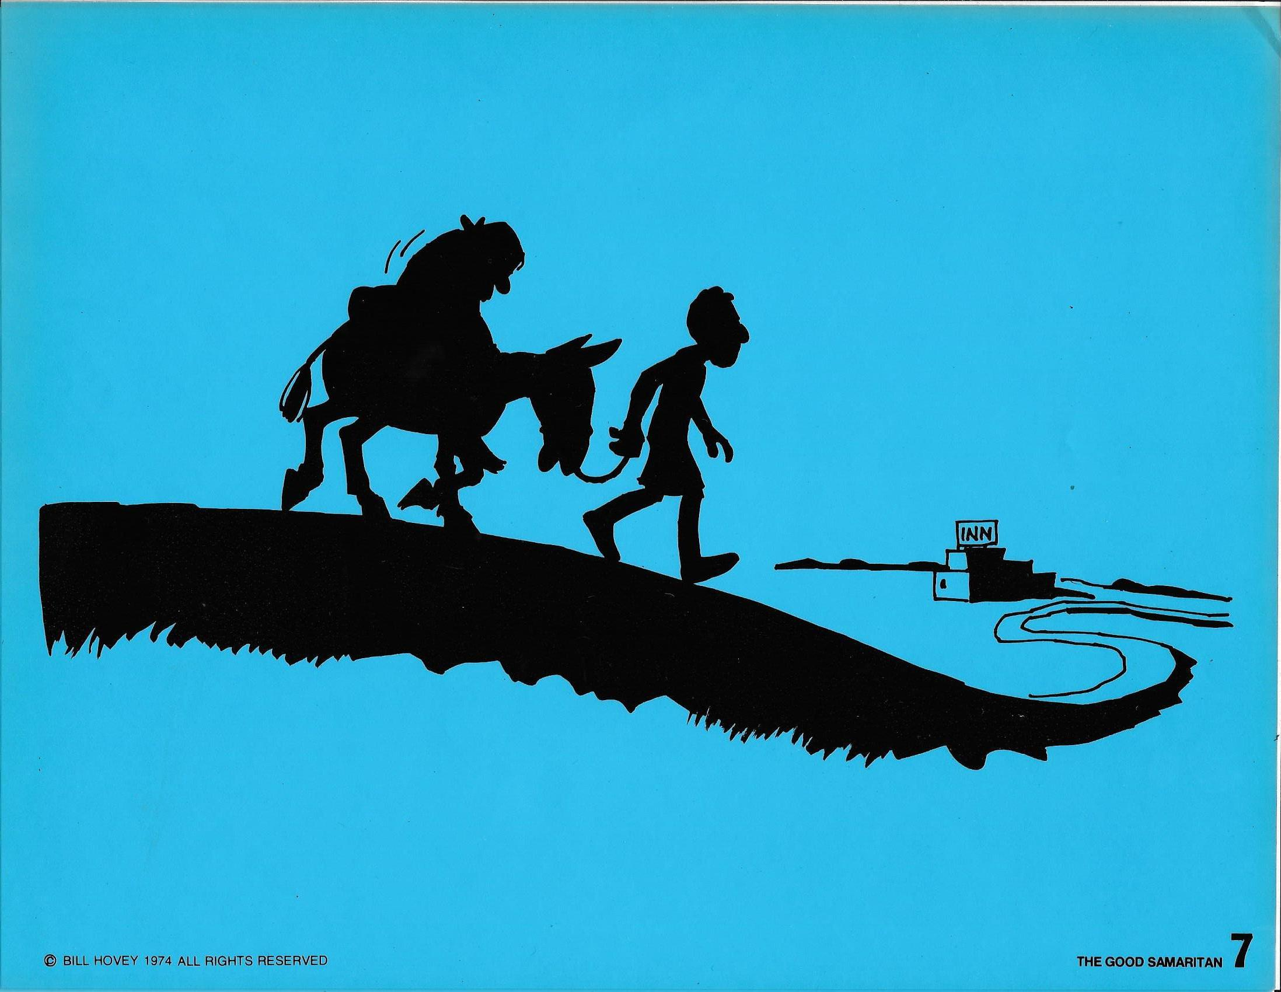
III. Love Does Not Count the Cost.

Slide 43
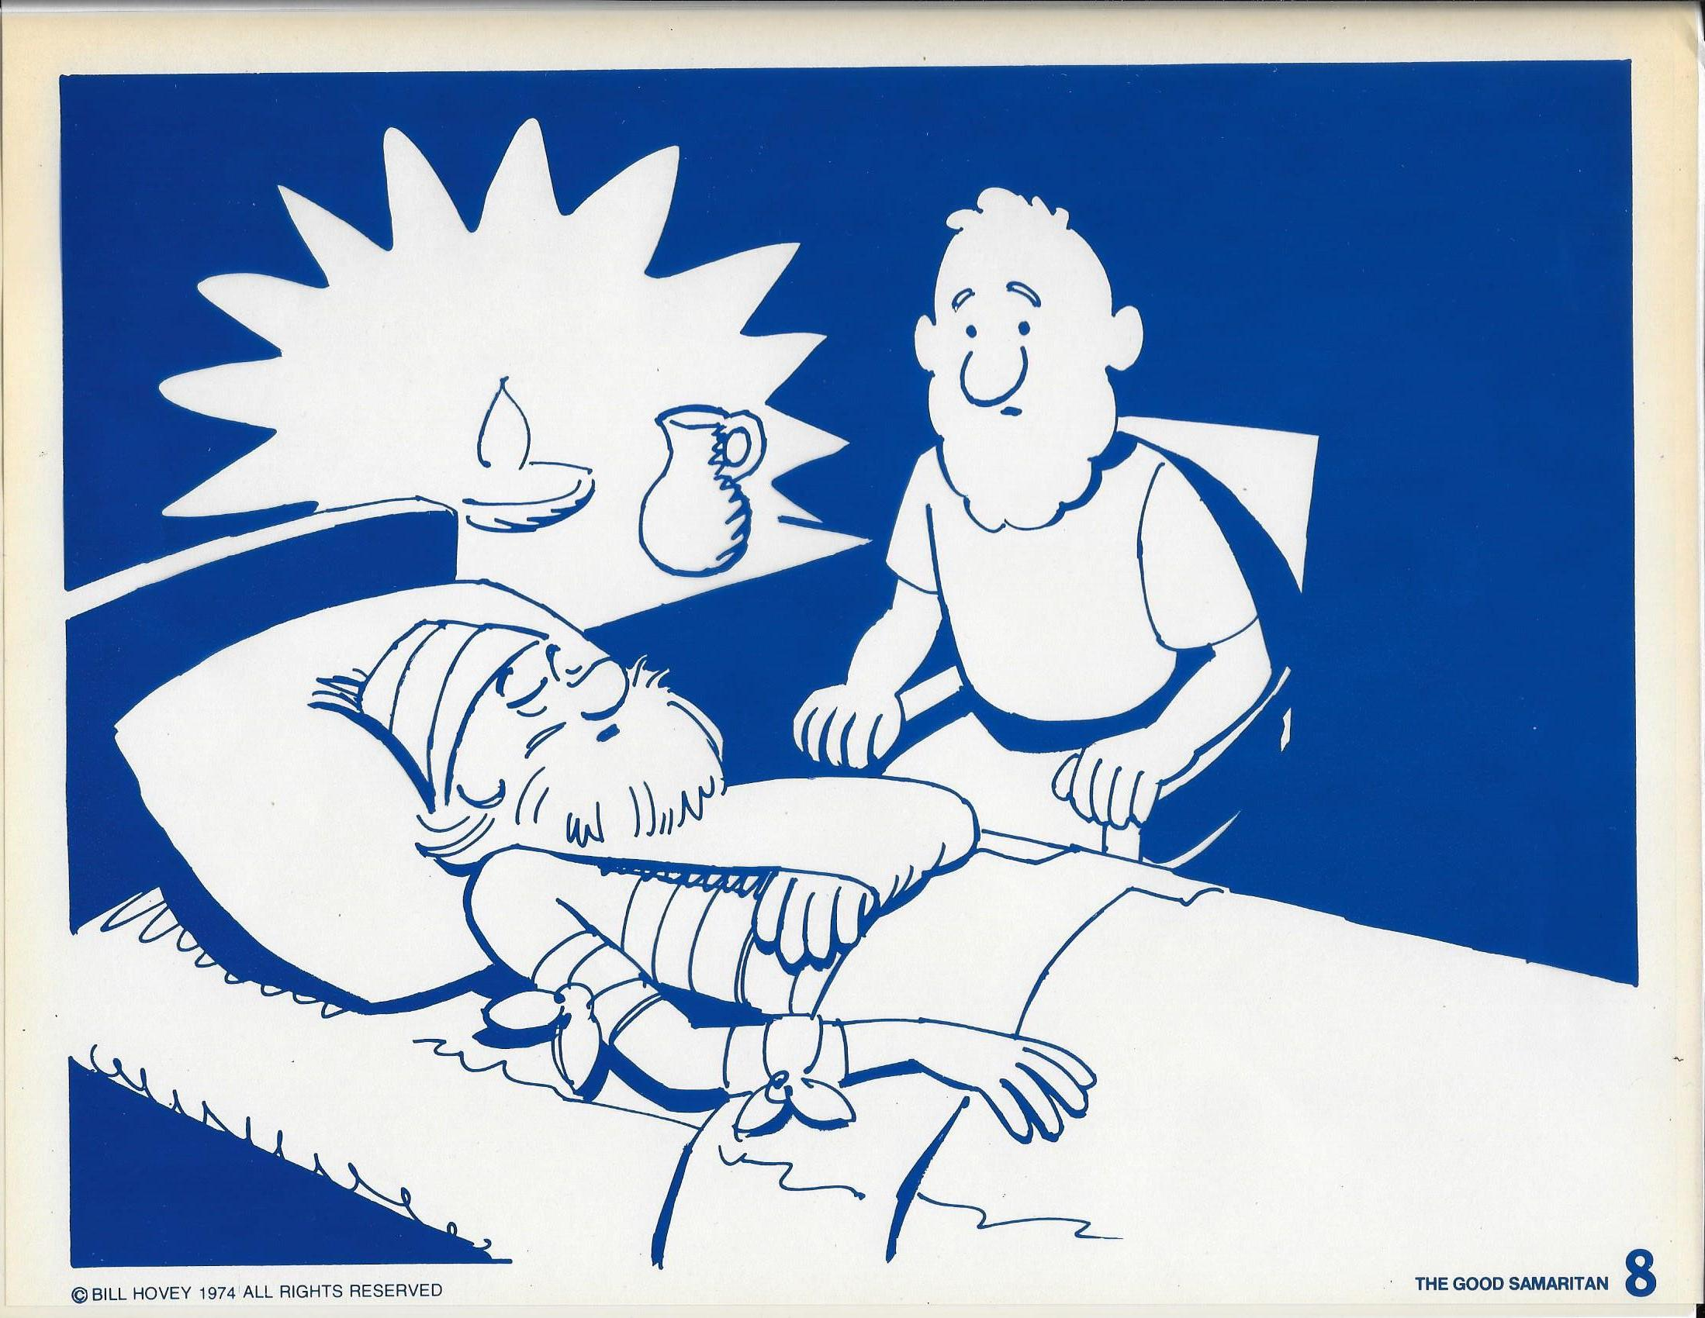
III. Love Does Not Count the Cost.

Slide 44
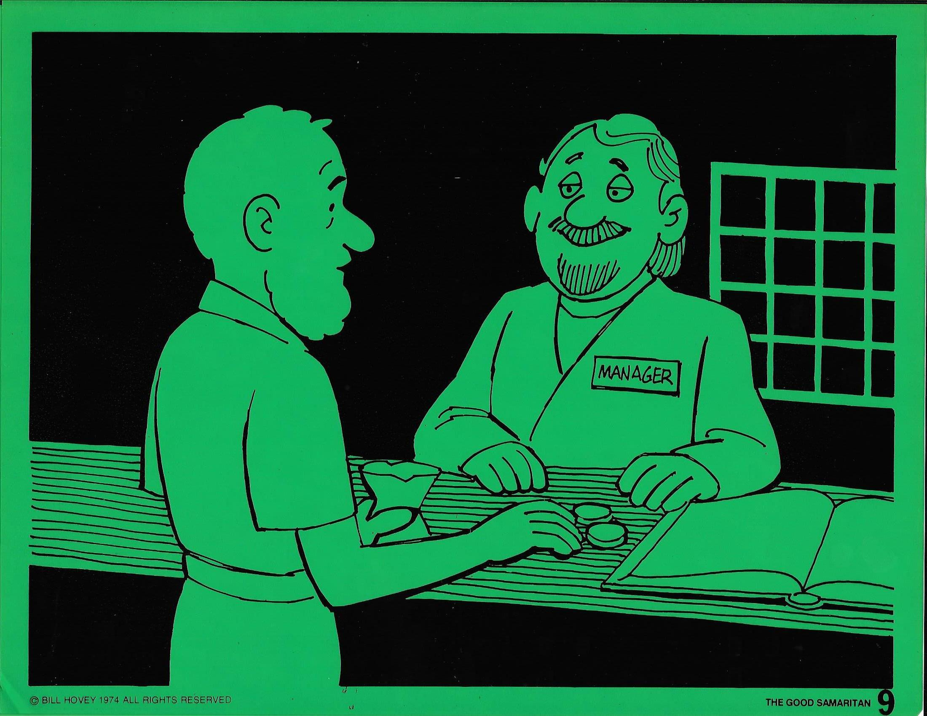
III. Love Does Not Count the Cost.

Slide 45
III. Love Does Not Count the Cost.
Romans 13:10 - Love does no harm to its neighbor. Therefore love is the fulfillment of the law.
B. How?

Slide 46
III. Love Does Not Count the Cost.
Romans 13:10 - Love does no harm to its neighbor. Therefore love is the fulfillment of the law.
B. How?
1. Love goes beyond the rules.

Slide 47
III. Love Does Not Count the Cost.
Romans 13:10 - Love does no harm to its neighbor. Therefore love is the fulfillment of the law.
B. How?
1. Love goes beyond the rules.
2. Love goes between the rules.

Slide 48
III. Love Does Not Count the Cost.
Romans 13:10 - Love does no harm to its neighbor. Therefore love is the fulfillment of the law.
B. How?
1. Love goes beyond the rules.
2. Love goes between the rules.
3. Love goes under the rules.

Slide 49
These Two Laws Sum Up
the Will of God!
The way you love God is by loving your neighbor!

Slide 50
