Slide 1
The Cost of Being a Disciple of Christ

Slide 2
Luke 9:51-56
As the time approached for him to be taken up to heaven, Jesus resolutely set out for Jerusalem. And he sent messengers on ahead, who went into a Samaritan village to get things ready for him; but the people there did not welcome him, because he was heading for Jerusalem. When the disciples James and John saw this, they asked, “Lord, do you want us to call fire down from heaven to destroy them?” But Jesus turned and rebuked them, and they went to another village.

Slide 3
Luke 9:51-56
As the time approached for him to be taken up to heaven, Jesus resolutely set out for Jerusalem. And he sent messengers on ahead, who went into a Samaritan village to get things ready for him; but the people there did not welcome him, because he was heading for Jerusalem. When the disciples James and John saw this, they asked, “Lord, do you want us to call fire down from heaven to destroy them?” But Jesus turned and rebuked them, and they went to another village.

Slide 4
Luke 9:51-56
As the time approached for him to be taken up to heaven, Jesus resolutely set out for Jerusalem. And he sent messengers on ahead, who went into a Samaritan village to get things ready for him; but the people there did not welcome him, because he was heading for Jerusalem. When the disciples James and John saw this, they asked, “Lord, do you want us to call fire down from heaven to destroy them?” But Jesus turned and rebuked them, and they went to another village.

Slide 5
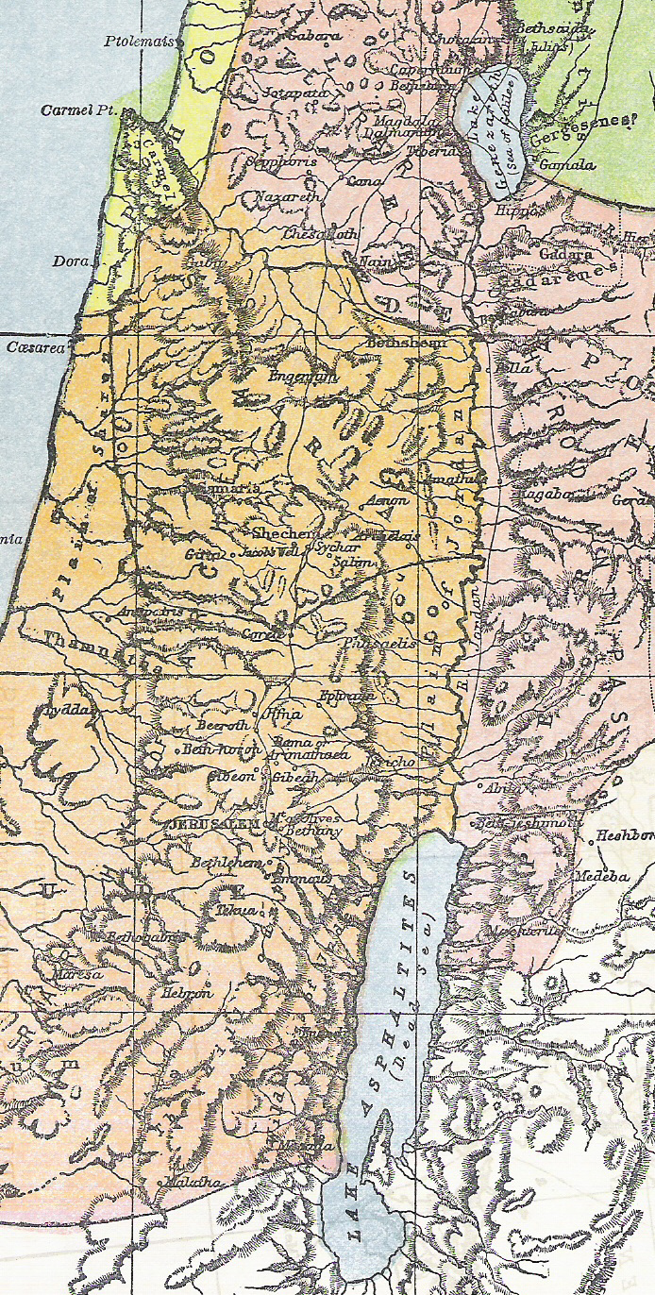

Slide 6
What’s the price
of being a disciple of Christ?

Slide 7
Matthew 8:18-22
When Jesus saw the crowd around him, he gave orders to cross to the other side of the lake. Then a teacher of the law came to him and said, “Teacher, I will follow you wherever you go.” Jesus replied, “Foxes have holes and birds of the air have nests, but the Son of Man has no place to lay his head.” Another disciple said to him, “Lord, first let me go and bury my father.” But Jesus told him, “Follow me, and let the dead bury their own dead.”

Slide 8
I. Discipleship Demands Ministry - v19-20.

Slide 9
I. Discipleship Demands Ministry
A. It was demanded of a scribe.
Then a teacher of the law came to him . . . - v19

Slide 10
I. Discipleship Demands Ministry
A. It was demanded of a scribe - v19.
1. The Feast of Tabernacles celebrated the giving of the Law.

Slide 11
I. Discipleship Demands Ministry
A. It was demanded of a scribe - v19.
1. The Feast of Tabernacles celebrated the giving of the Law.
2. A scribe was a professional copier of the Law.

Slide 12
I. Discipleship Demands Ministry
B. He wanted to be a disciple.
“Teacher, I will follow you wherever you go.” - v19

Slide 13
I. Discipleship Demands Ministry
B. He wanted to be a disciple - v19.
1. It was an honor for a scribe to call you a teacher.

Slide 14
I. Discipleship Demands Ministry
B. He wanted to be a disciple - v19.
1. It was an honor for a scribe to call you a teacher.
2. “I will follow you” = “I want to be a disciple”.

Slide 15
I. Discipleship Demands Ministry
C. But - he was not aware of the price!

Slide 16
I. Discipleship Demands Ministry
C. But - he was not aware of the price!
1. Disciple * = student.
* μαθητής

Slide 17
I. Discipleship Demands Ministry
C. But - he was not aware of the price!
1. Disciple * = student.
2. Apostle ** = one sent with a message.
* μαθητής ** ἀπόστολος

Slide 18
I. Discipleship Demands Ministry
C. But - he was not aware of the price!
1. Disciple * = student.
2. Apostle ** = one sent with a message.
3. So - a call to salvation = a call to ministry!
* μαθητής ** ἀπόστολος

Slide 19
I. Discipleship Demands Ministry
D. What is my job as a pastor to you?

Slide 20
I. Discipleship Demands Ministry
D. What is my job as a pastor to you?
Ephesians 4:11-13 - It was he who gave some to be apostles, some to be prophets, some to be evangelists, and some to be pastors and teachers, to prepare God’s people for works of service, so that the body of Christ may be built up until we all reach unity in the faith and in the knowledge of the Son of God and become mature, attaining to the whole measure of the fullness of Christ.

Slide 21
I. Discipleship Demands Ministry - v19-20
II. Discipleship Demands Absolute Loyalty - v21-22

Slide 22
II. Discipleship Demands Absolute Loyalty
A. It was demanded of “another” disciple - v21.

Slide 23
II. Discipleship Demands Absolute Loyalty
A. It was demanded of “another” disciple - v21.
1. Another (ἕτερος) = one of a different kind - not (ἄλλος), one of the same kind.

Slide 24
II. Discipleship Demands Absolute Loyalty
A. It was demanded of “another” disciple - v21.
2. What were the differences?
a. The scribe called Him “teacher” - the other “Lord”.

Slide 25
II. Discipleship Demands Absolute Loyalty
A. It was demanded of “another” disciple - v21.
2. What were the differences?
a. The scribe called Him “teacher” - the other “Lord”.
b. The scribe invited himself - the Lord invited this “other” man.

Slide 26
II. Discipleship Demands Absolute Loyalty
B. He wanted to be a disciple - v21.

Slide 27
II. Discipleship Demands Absolute Loyalty
B. He wanted to be a disciple - v21.
1. What was this obligation? The obligation of the first born son.

Slide 28
II. Discipleship Demands Absolute Loyalty
B. He wanted to be a disciple - v21.
1. What was this obligation? The obligation of the first born son.
2. The rabbis said it was more important than Bible study & prayer.

Slide 29
II. Discipleship Demands Absolute Loyalty
C. But - he was not aware of the price!
1. Jesus intended to send out the 70 disciples to “preach the kingdom” - Luke 10:1-24.

Slide 30
II. Discipleship Demands Absolute Loyalty
C. But - he was not aware of the price!
Luke 9:60 - Let the dead bury their own dead, but you go and proclaim the kingdom of God.

Slide 31
II. Discipleship Demands Absolute Loyalty
D. What must be the highest priority in your life?
Loyalty to God takes priority
over all earthly obligations!

Slide 32
II. Discipleship Demands Absolute Loyalty
D. What must be the highest priority in your life?
Matthew 16:26 - What good will it be for a man if he gains the whole world, yet forfeits his soul?

Slide 33
It’s when you orient everything in your life around obeying God -
That you are paying the price of discipleship!

