Slide 1
What is the church?

Slide 2
Matthew 16:13-18
When Jesus came to the region of Caesarea Philippi, he asked his disciples, “Who do people say the Son of Man is?” They replied, “Some say John the Baptist; others say Elijah; and still others, Jeremiah or one of the prophets.” “But what about you?” he asked. “Who do you say I am?” Simon Peter answered, “You are the Christ, the Son of the living God.” Jesus replied, “Blessed are you, Simon son of Jonah, for this was not revealed to you by man, but by my Father in heaven. And I tell you that you are Peter, and on this rock I will build my church, and the gates of Hades will not overcome it.

Slide 3
Matthew 16:13-18
When Jesus came to the region of Caesarea Philippi, he asked his disciples, “Who do people say the Son of Man is?” They replied, “Some say John the Baptist; others say Elijah; and still others, Jeremiah or one of the prophets.” “But what about you?” he asked. “Who do you say I am?” Simon Peter answered, “You are the Christ, the Son of the living God.” Jesus replied, “Blessed are you, Simon son of Jonah, for this was not revealed to you by man, but by my Father in heaven. And I tell you that you are Peter, and on this rock I will build my church, and the gates of Hades will not overcome it.

Slide 4
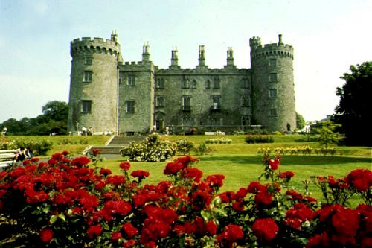
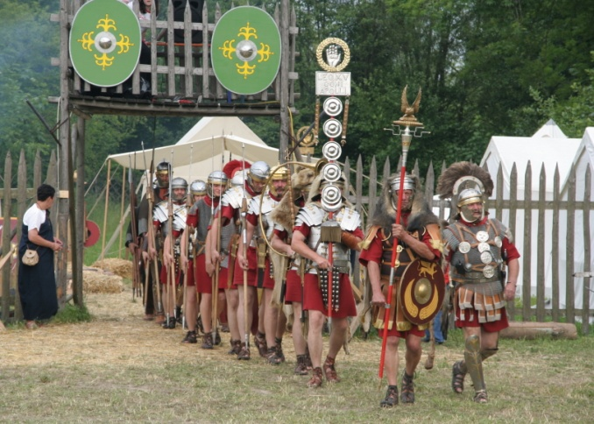
The Church The Kingdom of God | The Gates of Hades The World Satan’s Stronghold

Slide 5
The Gates of Hades The World Satan’s Stronghold | The Church The Kingdom of God

Slide 6
The fortifications of Satan’s stronghold can’t withstand the mighty army of God!

Slide 7
I. What the Church is Not!

Slide 8
I. What the Church is Not!
A. It is not this building.

Slide 9
I. What the Church is Not!
A. It is not this building.
B. It is not the worship service.

Slide 10
I. What the Church is Not!
A. It is not this building.
B. It is not the worship service.
C. It is not me! Or an institution!

Slide 11
I. What the Church is Not!
C. It is not me! Or an institution!
1. The clergy represent God.

Slide 12
I. What the Church is Not!
C. It is not me! Or an institution!
1. The clergy represent God.
2. Ordination is passed on through the generations.

Slide 13
I. What the Church is Not!
C. It is not me! Or an institution!
1. The clergy represent God.
2. Ordination is passed on through the generations.
3. Clergy have exclusive minis- tries as priests of God.

Slide 14
I. What the Church is Not!
C. It is not me! Or an institution!
1. The clergy represent God.
2. Ordination is passed on through the generations.
3. Clergy have exclusive minis- tries as priests of God.
4. Clergy control ministry.

Slide 15
I. What the Church is Not!
C. It is not me! Or an institution!
5. Operate under a chain of command.

Slide 16
I. What the Church is Not!
C. It is not me! Or an institution!
5. Operate under a chain of command.
6. Their scriptural authority is canon law.

Slide 17
I. What the Church is Not!
C. It is not me! Or an institution!
5. Operate under a chain of command.
6. Their scriptural authority is canon law.
7. Tend to focus on a charismatic leader or preacher.

Slide 18
I. What the Church is Not!
II. What the Church Is!

Slide 19
II. What the Church Is!
A. The original word.
1. Church * = an assembly, those called out from a group for a purpose.
* ἐκκλησία

Slide 20
II. What the Church Is!
A. The original word.
2. God’s house.
Ephesians 2:19-20 - you are no longer foreigners and aliens, but fellow citizens with God’s people and members of God’s household, built on the foundation of the apostles and prophets, with Christ Jesus himself as the chief cornerstone.
Hebrews 3:6 - Christ is faithful as a son over God’s house. And we are his house, if we hold on to our courage and the hpe of which we boast.

Slide 21
II. What the Church Is!
A. The original word.
2. God’s house.
I Peter 2:5 - ﻿ you also, like living stones, are being built into a spiritual house to be a holy priesthood, offering spiritual sacrifices acceptable to God through Jesus Christ.

Slide 22
II. What the Church Is!
A. The original word.
3. God’s temple.
I Corinthians 3:16 - Don’t you know that you yourselves are God’s temple and that God’s Spirit lives in you.
I Corinthians 6:19 - Do you not know that your body is a temple of the Holy Spirit, who is in you, whom you have received from God?

Slide 23
II. What the Church Is!
A. The original word.
4. We are living stones in this house.
I Peter 2:5 - you also, like living stones, are being built into a spiritual house to be a holy priesthood, offering spiritual sacrifices acceptable to God through Jesus Christ.

Slide 24
II. What the Church Is!
A. The original word.
B. How was this word used in the New Testament?

Slide 25
II. What the Church Is!
B. How was this word used in the New Testament?
1. A secular crowd.
Acts 19:32 - The assembly was in confusion: Some were shouting one thing, some another. Most of the people did not even know why they were there.

Slide 26
II. What the Church Is!
B. How was this word used in the New Testament?
1. A secular crowd.
Acts 19:32 - The assembly was in confusion: Some were shouting one thing, some another. Most of the people did not even know why they were there.
Acts 19:39 - If there is anything further you want to bring up, it must be settled in a legal assembly.

Slide 27
II. What the Church Is!
B. How was this word used in the New Testament?
2. The body throughout the world.
Galatians 1:13 - For you have heard of my previous way of life in Judaism, how intensely I persecuted the church of God and tried to destroy it.

Slide 28
II. What the Church Is!
B. How was this word used in the New Testament?
2. The body throughout the world.
Galatians 1:13 - For you have heard of my previous way of life in Judaism, how intensely I persecuted the church of God and tried to destroy it.
Ephesians 5:23 - For the husband is the head of the wife as Christ is the head of the church, his body, of which he is the Savior.

Slide 29
II. What the Church Is!
B. How was this word used in the New Testament?
2. The body throughout the world.
Hebrews 12:22-23 - You have come to thousands upon thousands of angels in joyful assembly, to the church of the firstborn, whose names are written in heaven.

Slide 30
II. What the Church Is!
B. How was this word used in the New Testament?
3. The church of a city.
Acts 13:1 - In the church at Antioch there were prophets and teachers.

Slide 31
II. What the Church Is!
B. How was this word used in the New Testament?
3. The church of a city.
Acts 13:1 - In the church at Antioch there were prophets and teachers.
I Corinthians 1:2 - To the church of God in Corinth . . .

Slide 32
II. What the Church Is!
B. How was this word used in the New Testament?
3. The church of a city.
Acts 13:1 - In the church at Antioch there were prophets and teachers.
I Corinthians 1:2 - To the church of God in Corinth . . .
Acts 8:1 - On that day a great persecution broke out against the church at Jerusalem

Slide 33
II. What the Church Is!
B. How was this word used in the New Testament?
3. The church of a city.
Acts 13:1 - In the church at Antioch there were prophets and teachers.
I Corinthians 1:2 - To the church of God in Corinth
Acts 8:1 - On that day a great persecution broke out against the church at Jerusalem . . .
Revelation 2:1 - “To the angel” of the church in Ephesus.

Slide 34
II. What the Church Is!
B. How was this word used in the New Testament?
4. A local congregation.
Romans 16:5 - Greet also the church that meets at their house.

Slide 35
II. What the Church Is!
B. How was this word used in the New Testament?
4. A local congregation.
Romans 16:5 - Greet also the church that meets at their house.
Colossians 4:15 - Give my greetings to the brothers at Laodicea, and to Nympha and the church in her house.

Slide 36
II. What the Church Is!
C. So - the church is you & me!

Slide 37
II. What the Church Is!
C. So - the church is you & me!
1. Together or separate.

Slide 38
II. What the Church Is!
C. So - the church is you & me!
1. Together or separate.
2. Meeting in this building or not.

Slide 39
II. What the Church Is!
C. So - the church is you & me!
1. Together or separate.
2. Meeting in this building or not.
3. We don’t have to be a corporation.

Slide 40
II. What the Church Is!
C. So - the church is you & me!
4. We are called:
a. Saints * = those who have been set apart from the world - holy ones.
Romans 1:7 - To all in Rome who are loved by God and called to be saints.
* ἅγιος

Slide 41
II. What the Church Is!
C. So - the church is you & me!
4. We are called:
b. The Way * = God’s way in contrast to the way of the world.
Acts 24:22 - Then Felix, who was well acquainted with the Way, adjourned the proceedings.
* τη̂ς ὁδου

Slide 42
II. What the Church Is!
C. So - the church is you & me!
5. The church obeyed & served God by:
a. By witnessing to the world.
Acts 8:4 - Those who had been scattered preached the word wherever they went.

Slide 43
II. What the Church Is!
C. So - the church is you & me!
5. The church obeyed & served God by:
b. Baptizing.
Acts 2:40-41 - With many other words he warned them; and he pleaded with them, “Save yourselves from this corrupt generation.” Those who accepted his message were baptized, and about three thousand were added to their number that day.

Slide 44
II. What the Church Is!
C. So - the church is you & me!
5. The church obeyed & served God by:
c. Making Disciples.
Acts 2:42 - They devoted themselves to the apostles’ teaching and to the fellowship, to the breaking of bread and to prayer.

Slide 45
II. What the Church Is!
C. So - the church is you & me!
5. The church obeyed & served God by:
d. Agreeing with mind & heart.
II Corinthians 13:11 - Aim for perfection, listen to my appeal, be of one mind, live in peace.

Slide 46
II. What the Church Is!
C. So - the church is you & me!
5. The church obeyed & served God by:
e. Encouraging, teaching & supporting.
I Thessalonians 5:11 - Therefore encourage one another and build each other up.

Slide 47
II. What the Church Is!
C. So - the church is you & me!
5. The church obeyed & served God by:
f. Helping the needy.
Acts 2:44-45 - All the believers were together and had everything in common. Selling their possessions and goods, they gave to anyone as he had need.

Slide 48
The Church:
1. The body of Christ.
2. The family of God.
3. The Way of truth.
4. The kingdom on earth; the Lord’s rule in our hearts!

